Slide 1

Data Visualization and Reporting Tool
Mojtaba Ghasemi

Slide 2

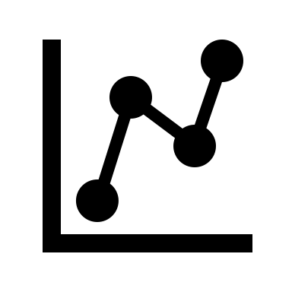



About me
Mojtaba Ghasemi
Senior Data Scientist
Ph.D. in Biomedical Engineering from University de Montreal
https://github.com/MJTGhasemi
https://ca.linkedin.com/in/mojtabaghasemi/
420-TT3-UM - Data Visualization and Reporting Tool | Montreal College IT

Slide 3
About you
- Background
- Enrolled program
- Highest education level
- Programming experience
420-TT3-UM - Data Visualization and Reporting Tool | Montreal College IT

Slide 4
Course Outline
- Data Foundation: Statistics
Descriptive Statistics
Introduction to Probability
Inferential Statistics
- Introduction to BI Solutions
Introduction to Business Intelligence
Introduction to Data Scientist
Introduction to Data Visualization
- Introducing Power BI and Power BI Services
Power BI Desktop
Designing Dashboards
Row-Level Security
- Power BI Data and Modeling
Transforming and Merging Data
Calculated Columns and Measures
420-TT3-UM - Data Visualization and Reporting Tool | Montreal College IT

Slide 5
Course Evaluations
- Assignments
25%
- Projects
25%
- Final Exam
50%
420-TT3-UM - Data Visualization and Reporting Tool | Montreal College IT

Slide 6

Data
Data refers to information gathered from different sources (sensor measurements, events, text, images, videos, etc.) through observations, measurements, research or analysis in order to provide:
Informed decision-making
Problem solving
Trend analysis
Performance measurement
Innovation
Personalization (tailor service to individual preferences)
Optimization
Risk management
Etc.
420-TT3-UM - Data Visualization and Reporting Tool | Montreal College IT

Slide 7
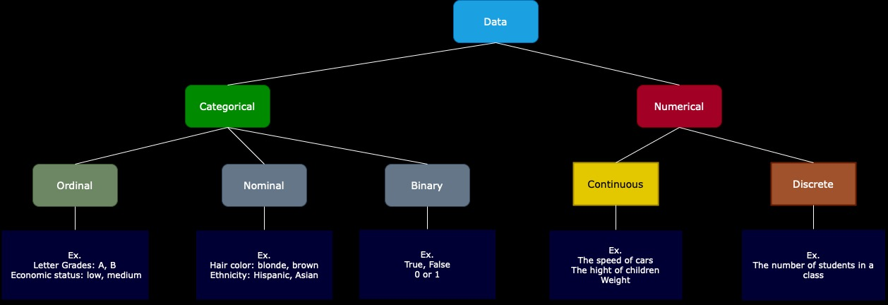
Data Types
Categorical: Data that can take on only a specific set of values representing a set of possible categories. (Synonyms: enums, enumerated, factors, nominal)
Binary: A special case of categorical data with just two categories of values, e.g., 0/1, true/false. (Synonyms: dichotomous, logical, indicator, boolean)
Ordinal: Categorical data that has an explicit ordering. (Synonym: ordered factor)
Nominal: represents discrete units and is used to label variables without providing any quantitative value or rank among categories
Numeric: Data that are expressed on a numeric scale.
Continuous: Data that can take on any value in an interval. (Synonyms: interval, float)
Discrete: Data that can take on only integer values, such as counts. (Synonyms: integer, count)
420-TT3-UM - Data Visualization and Reporting Tool | Montreal College IT

Slide 8
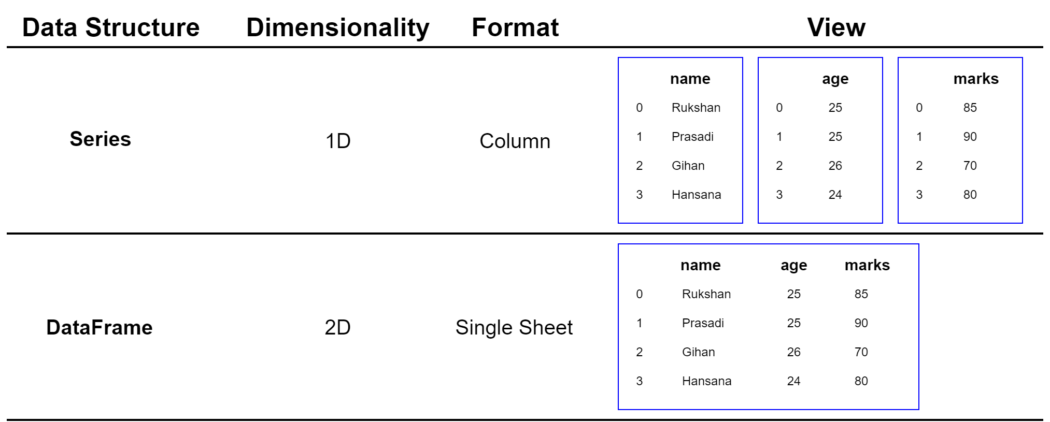
Data Structure
Series:
A Series is a one-dimensional labeled array capable of holding any data type. It is like a column in a table, ideal for representing one-dimensional data structures like a list of values.
DataFrame:
A two-dimensional labeled data structure with columns of potentially different types You can think of it like a spreadsheet or SQL table.
420-TT3-UM - Data Visualization and Reporting Tool | Montreal College IT

Slide 9
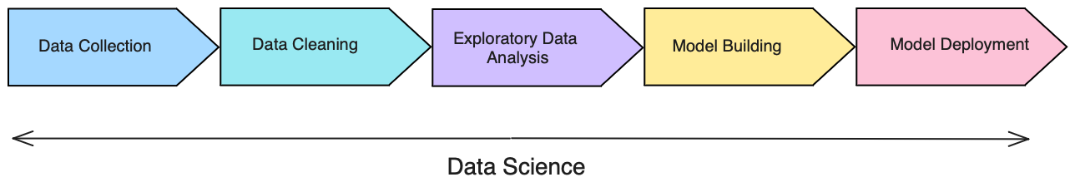
Understanding Data Cycle
- Data Collection: Aggregate and store data
- Data Cleaning: Data is usable and easily accessible
- Exploratory Data Analysis (EDA): Look for trends and high-level insights
- Model Building: Predict outcomes form the analysis
- Model Deployment: Make the model scalable for the business
420-TT3-UM - Data Visualization and Reporting Tool | Montreal College IT

Slide 10
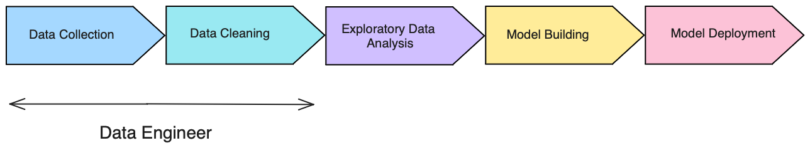
Understanding Data Cycle
Data Engineer:
Focuses on data collection and data cleaning
Strong SQL skills (pulling data and transforming it)
Extract, Transform, Load jobs (ETL)
Database maintenance techniques skills
420-TT3-UM - Data Visualization and Reporting Tool | Montreal College IT

Slide 11
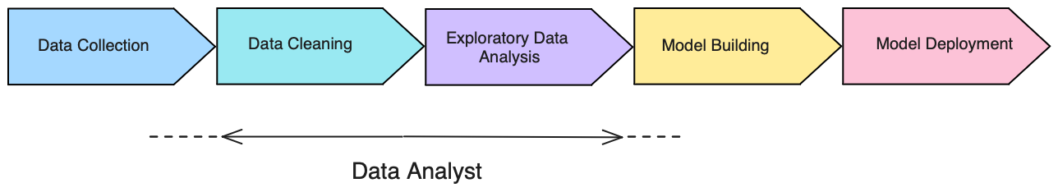
Understanding Data Cycle
Data / BI Analyst:
Focuses on data cleaning and EDA
Strong business intelligence skills (Excel, Power BI, Tableau)
Python, R skills
Do some data collection and model building tasks
420-TT3-UM - Data Visualization and Reporting Tool | Montreal College IT

Slide 12
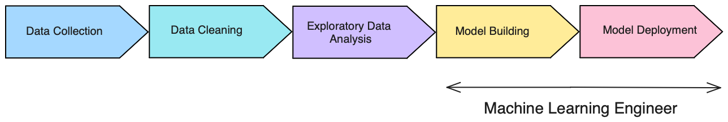
Understanding Data Cycle
Machine Learning Engineer (MLE):
Focuses on model building and putting models into production
Strong Python and other language (java, scala) skills
Strong understanding of ML tools and production environment
Software engineering skills
420-TT3-UM - Data Visualization and Reporting Tool | Montreal College IT

Slide 13
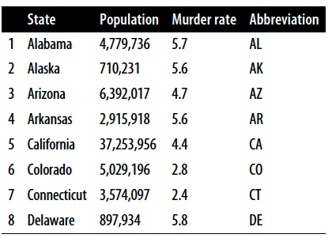
Statistics
What is statistics?
One of the best ways to get information from numerical data. It’s used to estimate or measure a parameter.
Why is statistics vital?
The important role of statistics is to represent unstructured data in the form of tables, graphs, and charts.
420-TT3-UM - Data Visualization and Reporting Tool | Montreal College IT

Slide 14
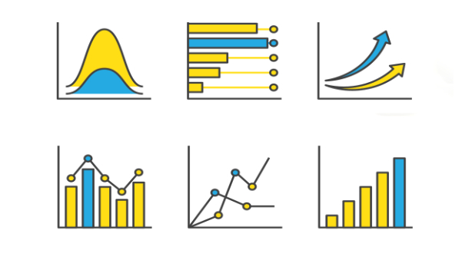
The important role of Statistics in Data Science
Statistics will provide a roadmap for the whole process of data science.
Statistics is one of the major parts of the data science field and helps us get better results from data, validating models and underlying patterns.
Statistics allows data scientists to quantify uncertainty and make predictions while accounting for randomness and variability in data.
Statistics enables decision-makers to derive insights from data through hypothesis testing, probability, and predictive modeling, leading to more informed and evidence-based decisions.
420-TT3-UM - Data Visualization and Reporting Tool | Montreal College IT

Slide 15
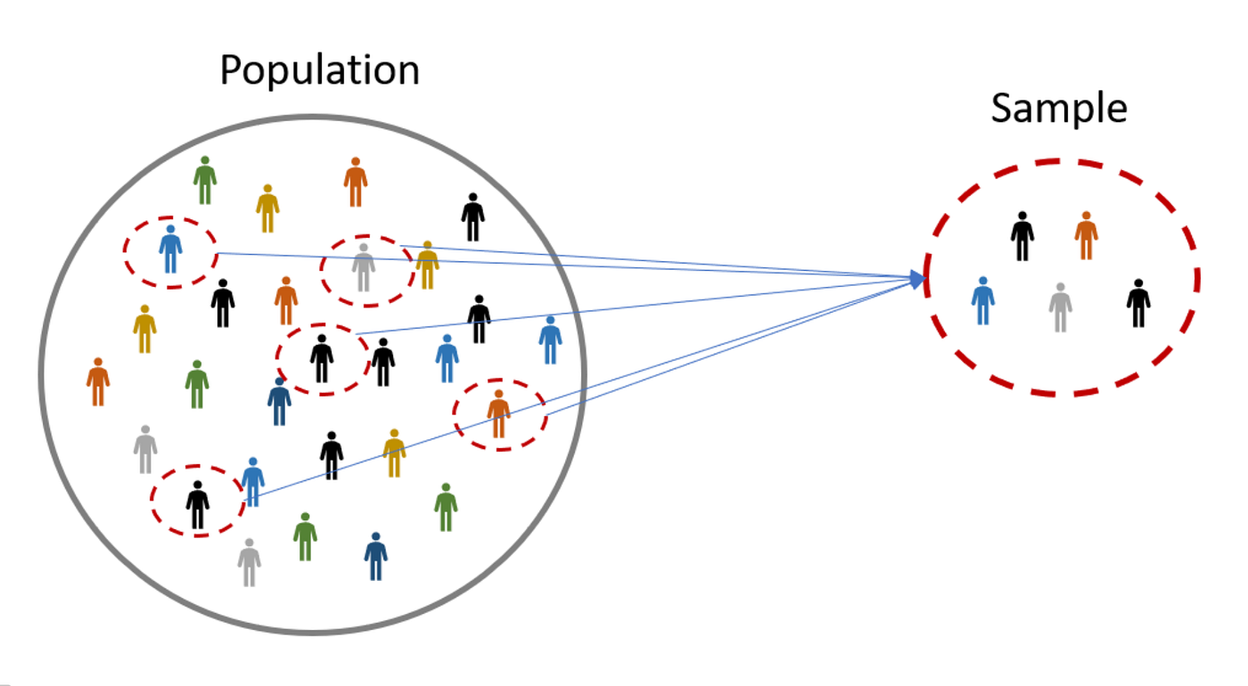
Sample & Population
Population: The entire group that you want to draw conclusions about.
Sample: A subset of the population that is used to represent the group.
420-TT3-UM - Data Visualization and Reporting Tool | Montreal College IT

Slide 16
Why Use a Sample
It is often impractical or impossible to study the whole population due to constraints of time, cost, and logistics.
Example of samples:
- A survey of 10,000 voters in a country.
- 50 trees selected from the forest for measurement.
- A group of 50 students chosen for a research study at an university
Random sampling:
Ensures that every member of the population has an equal chance of being selected, which helps to avoid bias and makes the sample representative of the population.
420-TT3-UM - Data Visualization and Reporting Tool | Montreal College IT

Slide 17
Random Sampling
Simple random sampling is a procedure in which
each member of the population is chosen strictly by chance
each member of the population is equally likely to be chosen
every possible sample of n objects is equally likely to be chosen
The resulting sample is called a random sample
420-TT3-UM - Data Visualization and Reporting Tool | Montreal College IT

Slide 18
Quiz: Identify the Sample and the Population
Scenario: A survey is conducted on 500 high school students about their eating habits.
Population: All high school students
Sample: The 500 high school students surveyed
Scenario: A company tests 30 out of its 500 software products for quality assurance.
Population: All 500 software products of the company
Sample: The 30 products tested
Scenario: In a city, a traffic study analyzes 200 randomly selected cars out of thousands during rush hour.
Population: All cars in the city during rush hour
Sample: The 200 cars selected for the study
Scenario: A researcher is studying the impact of a new teaching method on all the third-grade students in a school district.
Population: All third-grade students in the school district
Sample: A group of students
420-TT3-UM - Data Visualization and Reporting Tool | Montreal College IT

Slide 19
Descriptive and Inferential Statistics
Descriptive statistics
Collecting, summarizing, and processing data to transform data into information
Inferential statistics
Provide the basis for predictions, forecasts, and estimates that are used to transform information about samples into inferences about populations
420-TT3-UM - Data Visualization and Reporting Tool | Montreal College IT

Slide 20
Descriptive Statistics
Descriptive statistics involve summarizing and organizing and simplifying data in a way that provides meaningful information about a sample or population.
Types of Descriptive statistics:
Organizing Data
Tables
Graphs (Bar Charts, Histograms, Line Graphs, Pie Charts, Scatter Plots, Box Plots)
2. Summarizing Data
Measures of Central Tendency (Mean, Median, mode)
Measures of Variation (Range, Interquartile Range, Variance, Standard Deviation)
Measures of Shape (Skewness, Kurtosis)
Measures of Association (Covariance, Correlation)
420-TT3-UM - Data Visualization and Reporting Tool | Montreal College IT

Slide 21
Frequency Distribution of IQ for Employees
IQ | Frequency
82.00 | 1
87.00 | 1
89.00 | 1
93.00 | 1
96.00 | 2
97.00 | 1
102.00 | 1
103.00 | 1
105.00 | 1
109.00 | 1
115.00 | 2
119.00 | 1
120.00 | 1
127.00 | 1
131.00 | 2
140.00 | 1
144.00 | 3
162.00 | 1
Total | 24
Organizing Data
Tables:
Frequency Tables: Display the frequency of various outcomes in a sample.
Data Tables: Standard tables that represent data with rows and columns.
Age | Gender | Education Level | Job Title | Years of Experience
32 | Male | Bachelor’s | Software Engineer | 5
28 | Female | Master’s | Data Analyst | 3
45 | Male | PhD | Senior Manager | 15
36 | Female | Bachelor’s | Sales Associate | 7
420-TT3-UM - Data Visualization and Reporting Tool | Montreal College IT

Slide 22
Organizing Data
Age | Gender | Education Level | Job Title | Department | Years of Experience | Salary
32 | Male | Bachelor’s | Software Engineer | IT | 5 | 90000
28 | Female | Master’s | Data Analyst | Data | 3 | 65000
45 | Male | PhD | Senior Manager | Operations | 15 | 150000
36 | Female | Bachelor’s | Sales Associate | Sales | 7 | 60000
52 | Male | Master’s | Director | Operations | 20 | 200000
29 | Male | Bachelor’s | Marketing Analyst | Data | 2 | 55000
42 | Female | Master’s | Product Manager | Operations | 12 | 120000
31 | Male | Bachelor’s | Sales Manger | Sales | 4 | 80000
26 | Female | Bachelor’s | Marketing Coordinator | Marketing | 1 | 45000
38 | Male | PhD | Senior Scientist | Operations | 10 | 110000
29 | Male | Master’s | Software Developer | IT | 3 | 75000
48 | Female | Bachelor’s | HR Manager | Human Resources | 18 | 140000
35 | Male | Bachelor’s | Financial Analyst | Data | 6 | 65000
40 | Female | Master’s | Project Manager | Operations | 14 | 130000
27 | Male | Bachelor’s | Customer Service Rep | Operations | 2 | 40000
44 | Male | Bachelor’s | Operations Manager | Operations | 16 | 125000
33 | Female | Master’s | Marketing Manager | Marketing | 7 | 90000
39 | Male | PhD | Senior Engineer | IT | 12 | 115000
Example:
Dataset of 373 employees’ information from a software company
420-TT3-UM - Data Visualization and Reporting Tool | Montreal College IT

Slide 23
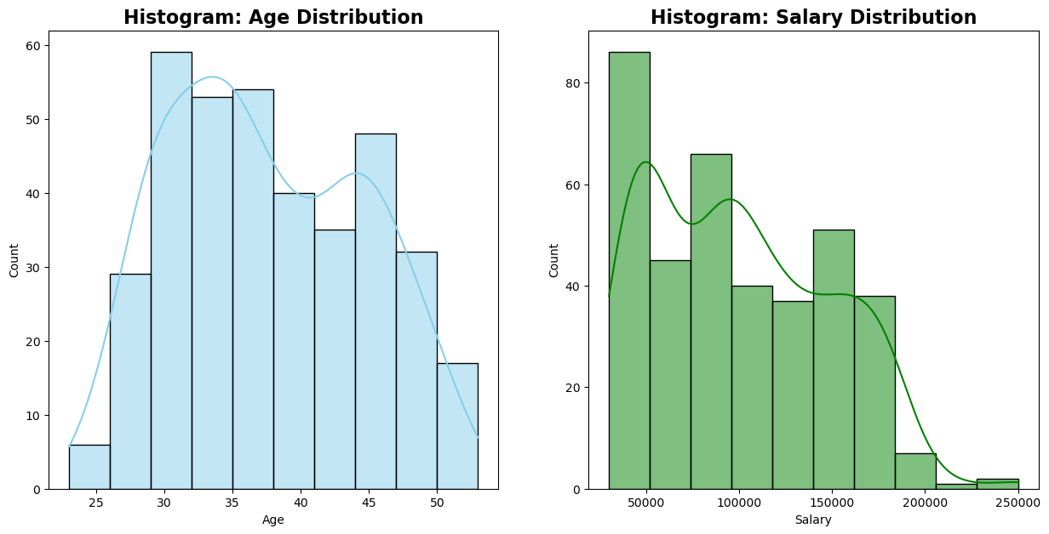
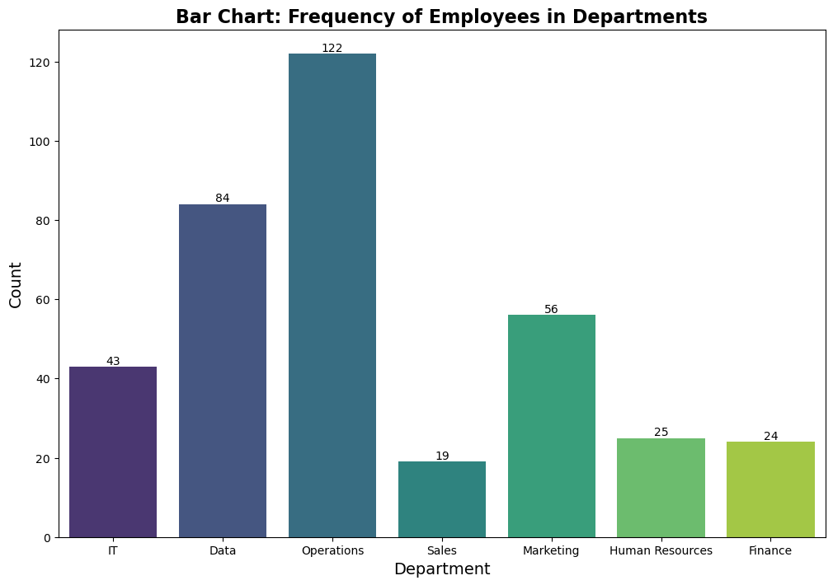
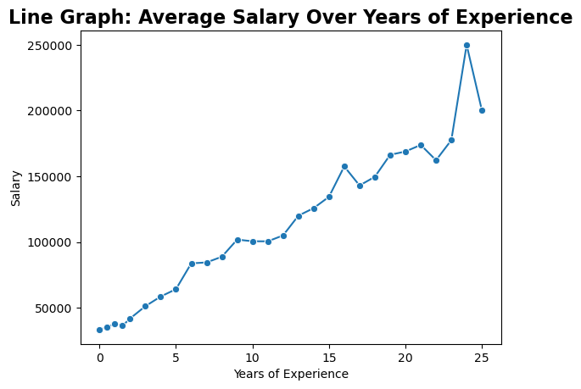
Organizing Data
Graphs:
420-TT3-UM - Data Visualization and Reporting Tool | Montreal College IT

Slide 24
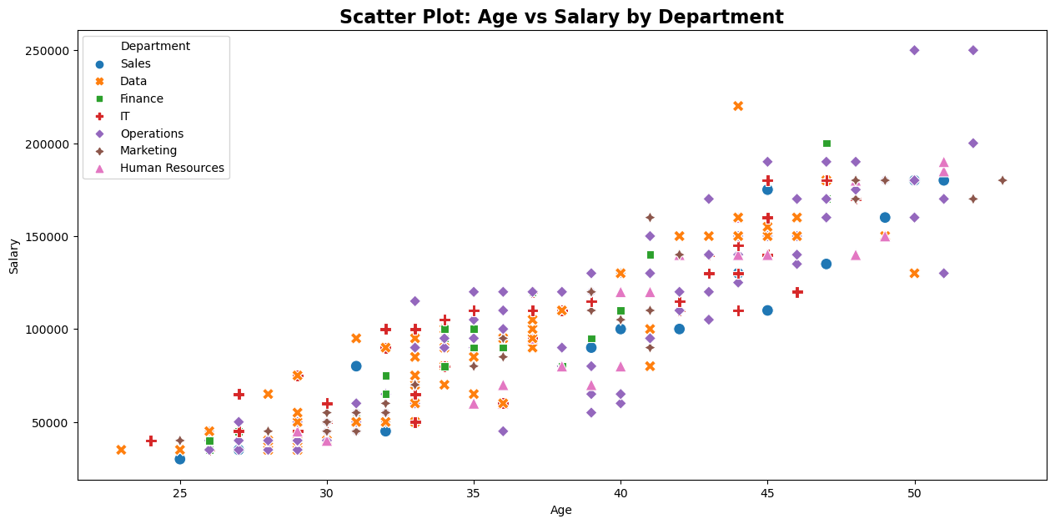
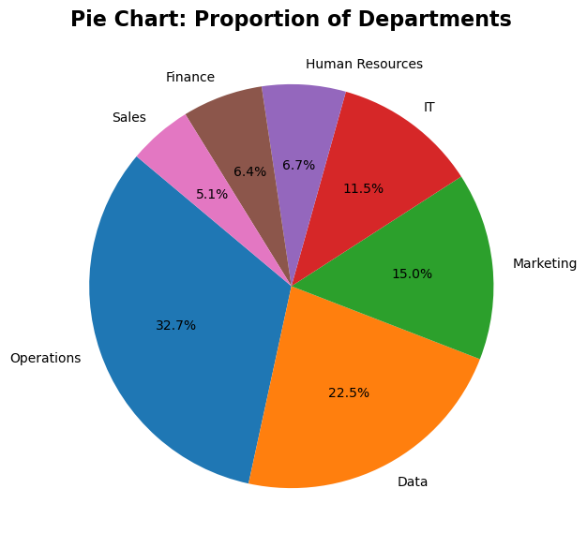
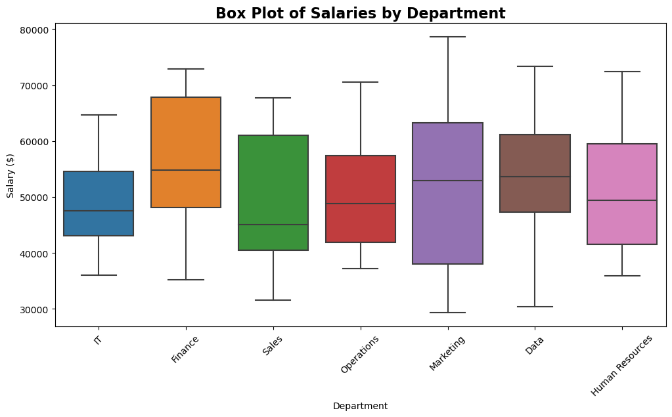
Organizing Data
Graphs:
420-TT3-UM - Data Visualization and Reporting Tool | Montreal College IT

Slide 25
Quiz: Identify the trends and insights from Graphs
Bar Chart:
The Operations department has the highest number of employees.
Sales has the least number of employees.
Histogram:
The Age Distribution histogram shows a roughly bell-shaped curve, but it's slightly right-skewed, indicating a larger number of employees in the middle to older age brackets.
The presence of the right tail in the Salary Distribution suggests that there are outliers or a small number of employees who earn much more than their colleagues.
Line Graph:
There is a general upward trend, indicating that salary increases with years of experience.
There is a significant spike in salary at around 25 years of experience. This could represent a few highly compensated individuals skewing the average or a specific promotion/compensation after 25 years that brings a substantial pay increase.
420-TT3-UM - Data Visualization and Reporting Tool | Montreal College IT

Slide 26
Quiz: Identify the trends and insights from Graphs
Pie Chart:
Scatter Plot:
Box Plot:
Send Your answers in the course channel before the start of next session
420-TT3-UM - Data Visualization and Reporting Tool | Montreal College IT

Slide 27
Graphs Presentation of Data
Categorical
Variables
Numerical
Variables
Frequency distribution
Bar chart
Pie chart
Line chart
Frequency distribution
Histogram
Scatter plot
Box plot
420-TT3-UM - Data Visualization and Reporting Tool | Montreal College IT

Slide 28
Summarizing Data
a. Measures of Central Tendency
Central tendency statistics provide insights into the center or typical value of a dataset, helping to understand where most data points cluster.
Let y denote a quantitative variable, with observations y₁ , y₂ , y₃ , … , y_{n}
- Median: Middle measurement or value in a sorted sample (50th Percentile)
- Mean: The average of all data point
- Mode: The most frequently occurring value(s) in a dataset
Why is it called the "measures of central tendency”?
420-TT3-UM - Data Visualization and Reporting Tool | Montreal College IT

Slide 29
Mean
Example:
Class A--IQs of 13 Students
102 115
128 109
131 89
98 106
140 119
93 97
110
Class B--IQs of 13 Students
127 162
131 103
96 111
80 109
93 87
120 105
109
Mean_{A} = $\frac{1437}{13}$ = 110.54 Mean_{B} = $\frac{1433}{13}$ = 110.23
420-TT3-UM - Data Visualization and Reporting Tool | Montreal College IT

Slide 30
Median
Class A--IQs of 13 Student (odd Number)
89
93
97
98
102
106
109
110
115
119
128
131
140
If the first student were to drop out of Class A
89
93
97
98
102
106
109
110
115
119
128
131
140
Example:
Median = 109
(six cases above, six below)
Median = 109.5
109 + 110 = 219/2 = 109.5
(six cases above, six below)
420-TT3-UM - Data Visualization and Reporting Tool | Montreal College IT

Slide 31
Properties of Mean and Median
For symmetric distributions, mean = median
Means can be badly affected by Outliers (data points with extreme values unlike the rest)
Median is unaffected by outliers, making it a better measure of central tendency
If the recorded values for a variable form a symmetric distribution, the median and mean are identical.
In skewed data, the mean lies further toward the skew than the median.
Symmetric (Normal)
Skewed
Mean
Median
Mean
Median
420-TT3-UM - Data Visualization and Reporting Tool | Montreal College IT

Slide 32
Mean and Median and Mode
Example:
New York Yankees baseball team, 2006
mean salary = $4.6 million
median salary = $2.8 million
mode = $1.9 million
How possible? Direction of skew?
Give an example for which you would expect
mean < median
Send Your answers in the course channel before the start of next session
420-TT3-UM - Data Visualization and Reporting Tool | Montreal College IT

Slide 33
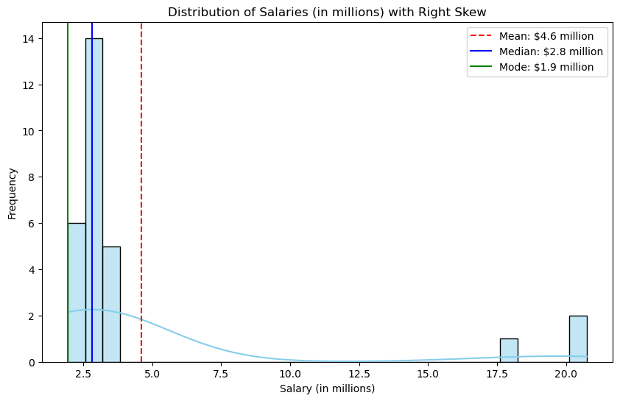
Mean and Median and Mode
Example:
New York Yankees baseball team, 2006
mean salary = $4.6 million
median salary = $2.8 million
mode = $1.9 million
How possible? Direction of skew?
Give an example for which you would expect
mean < median
Send Your answers in the course channel before the start of next session
420-TT3-UM - Data Visualization and Reporting Tool | Montreal College IT

Slide 34
Mode
Example:
Mode: The most common data point is called the mode.
The combined IQ scores for Classes A & B:
80 87 89 93 93 96 97 98 102 103 105 106 109 109 109 110 111 115 119 120 127
128 131 131 140 162
It is possible to have more than one mode!
A la mode!!
420-TT3-UM - Data Visualization and Reporting Tool | Montreal College IT

Slide 35
Symmetric (Normal)
Mode
In symmetric distributions, the mean, median, and mode are the same.
In skewed data, the mean and median lie further toward the skew than the mode.
Mean
Median
Mode
Skewed
Mode
Median
Mean
420-TT3-UM - Data Visualization and Reporting Tool | Montreal College IT

Slide 36
Takeaways
Mean: The mean, or average, is the sum of all values divided by the number of values. It's sensitive to outliers and provides a balanced representation of the dataset.
Median: The median is the middle value when the data is ordered. It's less affected by outliers and gives a better sense of the central value in skewed datasets.
Mode: The mode is the value that appears most frequently in the dataset. It can be helpful to for categorical data and is not affected by extreme values.
420-TT3-UM - Data Visualization and Reporting Tool | Montreal College IT

Slide 37
More on Distribution Shape
The shape of the distribution is said to be Symmetric (Normal) if the observations are balanced, or evenly distributed, about the center.
420-TT3-UM - Data Visualization and Reporting Tool | Montreal College IT

Slide 38
More on Distribution Shape
The shape of the distribution is said to be skewed if the observations are not symmetrically distributed around the center.
A positively skewed distribution (skewed to the right) has a tail that extends to the right in the direction of positive values.
A negatively skewed distribution (skewed to the left) has a tail that extends to the left in the direction of negative values.
420-TT3-UM - Data Visualization and Reporting Tool | Montreal College IT

Slide 39
Summarizing Data
b. Measures of Variation (Dispersion)
Dispersion statistics quantify the spread or variability of data points around a central value, helping to understand how data is distributed.
Range
Interquartile Range (IQR)
Variance
Standard Deviation
420-TT3-UM - Data Visualization and Reporting Tool | Montreal College IT

Slide 40
Range
The range is the difference between the maximum and minimum values in the dataset. It provides a simple measure of how widely the data is spread.
Example:
Let’s have this dataset: [78, 85, 92, 78, 88, 95, 82, 88, 90, 78]
Range Calculation:
To calculate the range, you subtract the smallest value from the largest value.
Largest value = 95, Smallest value = 78
Range = Largest value -Smallest value = 95 -78 = 17
So, for the given dataset, Range = 17
420-TT3-UM - Data Visualization and Reporting Tool | Montreal College IT

Slide 41
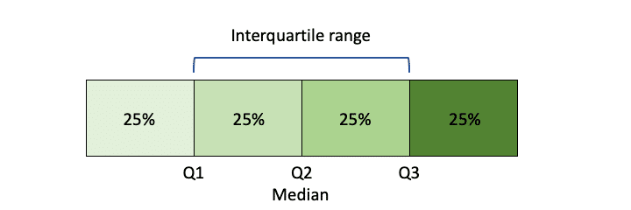
Interquartile Range (IQR)
IQR is the range between the first quartile (25th percentile) and the third quartile (75th percentile) of the data. It measures the spread of the middle 50% of the dataset, providing a robust measure less affected by outliers.
Example:
Let's calculate IQR for the dataset of exam scores: [78, 85, 92, 78, 88, 95, 82, 88, 90, 78]
Step 1: Order the Data
First, you need to order the data in ascending order: [78, 78, 78, 82, 85, 88, 88, 90, 92, 95]
Step 2: Calculate Quartiles
Find the median (Q2): (85 + 88) / 2 = 86.5 (average of the 5th and 6th values)
Find the lower quartile (Q1), which is the median of the lower half: 78
Find the upper quartile (Q3), which is the median of the upper half: 90
Step 3: Calculate IQR
IQR = Q3 - Q1 = 90 - 78 = 12
420-TT3-UM - Data Visualization and Reporting Tool | Montreal College IT

Slide 42
Interquartile Range (IQR)
Example:
Find the following for the “Salary” column of the “Employee_Salary” dataset
Min
Max
Q1
Median or Q2
Q3
IQR
Salary
30000
35000
35000
35000
35000
35000
35000
35000
40000
40000
45000
35000
35000
35000
35000
35000
35000
40000
40000
40000
45000
45000
Manual
420-TT3-UM - Data Visualization and Reporting Tool | Montreal College IT

Slide 43
Interquartile Range (IQR)
Example:
Find the following for the “Salary” field of the “Employee_Salary” dataset
Microsoft Excel
Min = MIN(G2:G374)
Max = Max(G2:G374)
Mean = AVERAGE(G2:G374)
Median = MEDIAN(G2:G374)
Mode = MODE.SNGL(G2:G374)
Q1 = PERCENTILE(G2:G374, 0.25)
Q3 = PERCENTILE(G2:G374, 0.75)
IQR = Q3 – Q1
Python
salary_min = df['Salary'].min()
salary_max = df['Salary'].max()
salary_mean = df['Salary'].mean()
salary_median = df['Salary'].median()
salary_mode = df['Salary'].mode()
Q1 = df['Salary'].quantile(0.25)
Q3 = df['Salary'].quantile(0.75)
IQR = Q3 - Q1
420-TT3-UM - Data Visualization and Reporting Tool | Montreal College IT

Slide 44
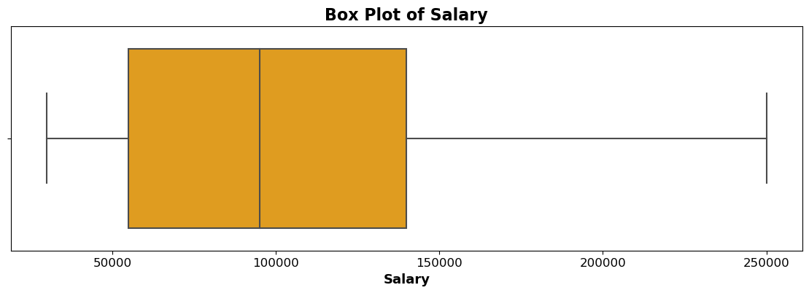
Interquartile Range (IQR)
Example:
Find the following for the “Salary” field of the “Employee_Salary” dataset
Q1 = 55000
Max = 250000
Min = 30000
Median = 95000
Q3 = 140000
420-TT3-UM - Data Visualization and Reporting Tool | Montreal College IT

Slide 45
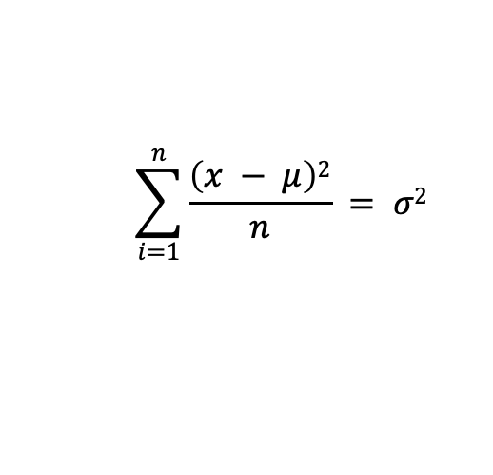
Variance
The variance measures how much individual data points deviate from the mean. It involves squaring the differences between each data point and the mean, summing those squares, and then dividing by the number of data points.
Step 1
78
78
78
82
85
88
88
90
92
95
85.4
Step 2
78 – 85.4 | -7.4
78 – 85.4 | -7.4
78 – 85.4 | -7.4
82 – 85.4 | -3.4
85 – 85.4 | -0.4
88 – 85.4 | 2.6
88 – 85.4 | 2.6
90 – 85.4 | 4.6
92 – 85.4 | 6.6
95 – 85.4 | 9.6
Step 3
(-7.4)² | 54.76
(-7.4)² | 54.76
(-7.4)² | 54.76
(-3.4)² | 11.56
(-0.4)² | 0.16
(2.6)² | 6.76
(2.6)² | 6.76
(4.6)² | 21.16
(6.6)² | 43.56
(9.6)² | 92.16
Step 4
54.76
54.76
54.76
11.56
0.16
6.76
6.76
21.16
43.56
92.16
34.46
$$\sum_{i=1}^{n}{\frac{\left(x − μ\right)2}{n}} = σ2$$
Mean
Mean
= Variance
420-TT3-UM - Data Visualization and Reporting Tool | Montreal College IT

Slide 46
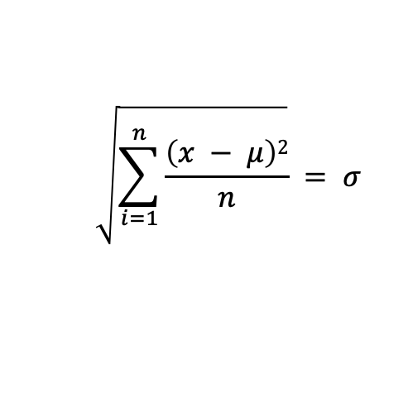
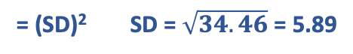
Standard Deviation (SD)
The standard deviation is the square root of the variance. It indicates the average deviation of data points from the mean. A higher standard deviation implies greater dispersion.
Step 1
78
78
78
82
85
88
88
90
92
95
85.4
Step 2
78 – 85.4 | -7.4
78 – 85.4 | -7.4
78 – 85.4 | -7.4
82 – 85.4 | -3.4
85 – 85.4 | -0.4
88 – 85.4 | 2.6
88 – 85.4 | 2.6
90 – 85.4 | 4.6
92 – 85.4 | 6.6
95 – 85.4 | 9.6
Step 3
(-7.4)² | 54.76
(-7.4)² | 54.76
(-7.4)² | 54.76
(-3.4)² | 11.56
(-0.4)² | 0.16
(2.6)² | 6.76
(2.6)² | 6.76
(4.6)² | 21.16
(6.6)² | 43.56
(9.6)² | 92.16
Step 4
54.76
54.76
54.76
11.56
0.16
6.76
6.76
21.16
43.56
92.16
34.46
$$\sqrt{\sum_{i=1}^{n}{\frac{\left(x − μ\right)2}{n}}} = σ$$
Step 5
Mean
Mean
= (SD)² SD = $\sqrt{34.46}$ = 5.89
420-TT3-UM - Data Visualization and Reporting Tool | Montreal College IT

Slide 47
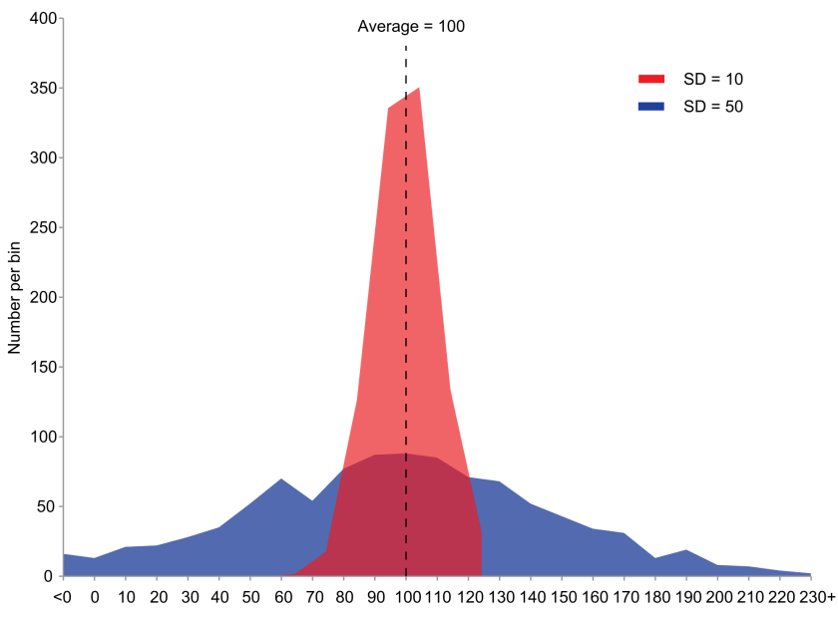
What does the SD tell us?
The standard deviation is a measure of the amount of variation or dispersion present in a dataset.
It quantifies how spread out the data points are from the mean value.
A higher standard deviation indicates greater variability among the data points, while a smaller standard deviation indicates that the data points are closely clustered around the mean
420-TT3-UM - Data Visualization and Reporting Tool | Montreal College IT

Slide 48
Variance vs. Standard Deviation
The standard deviation is measured in the same units as the original data, making it more intuitive to understand and interpret.
Variance, being in squared units, can be less straightforward to grasp.
The standard deviation is less sensitive to extreme values.
Aspect | Variance | Standard Deviation
Calculation | Average of squared differences from the mean | Square root of the variance
Units | Squared units (e.g., squared meters, squared USD) | Same units as the original data
Interpretation | Gives an idea of the spread of data | Provides a clearer measure of spread
Sensitivity to Data | Sensitive to extreme values (squares differences) | Less sensitive (square root reduces impact)
Magnitude | Larger values, less intuitive interpretation | Smaller values, easier to interpret
Comparison | Harder to compare between different datasets | Easier to compare across datasets
420-TT3-UM - Data Visualization and Reporting Tool | Montreal College IT

Slide 49
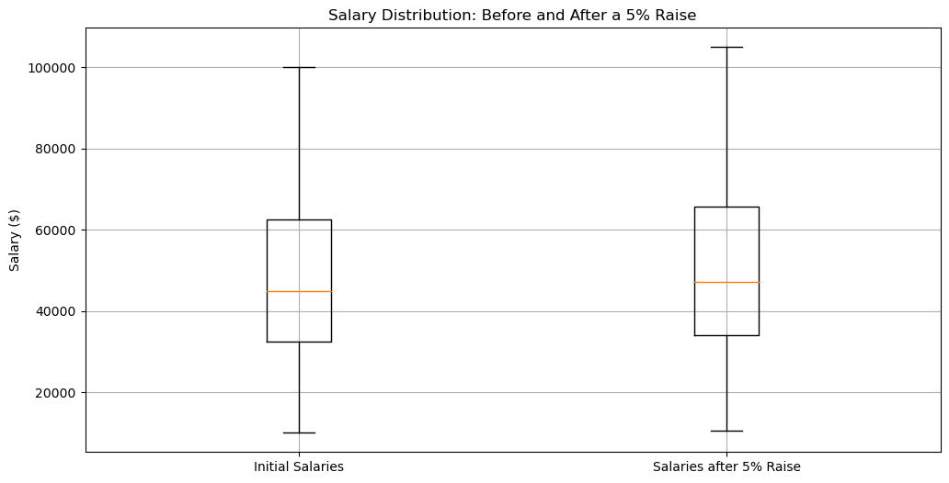
Assignment for Variance and SD
Refer to the Word file for details.
Position | Salary
President | $100,000
Manager | $50,000
Secretary | $40,000
Maintenance Worker | $10,000
420-TT3-UM - Data Visualization and Reporting Tool | Montreal College IT

Slide 50
Descriptive Statistics
Descriptive statistics involve summarizing and organizing and simplifying data in a way that provides meaningful information about a sample or population.
Types of Descriptive statistics:
Organizing Data
Tables
Graphs (Bar Charts, Histograms, Line Graphs, Pie Charts, Scatter Plots, Box Plots)
2. Summarizing Data
Measures of Central Tendency (Mean, Median, mode)
Measures of Variation (Range, Interquartile Range, Variance, Standard Deviation)
Measures of Shape (Skewness, Kurtosis)
Measures of Association (Covariance, Correlation)
420-TT3-UM - Data Visualization and Reporting Tool | Montreal College IT

Slide 51
Summarizing Data
c. Measures of Shape
Skewness is the tendency of the deviations from the mean to be larger in one direction than in the other. Tendency for one tail of the distribution to be heavier than the other.
Kurtosis is a measure of the relative peakedness or flatness of the frequency distribution curve. The kurtosis of a normal distribution is zero.
420-TT3-UM - Data Visualization and Reporting Tool | Montreal College IT

Slide 52
Skewness and Kurtosis
The measures of central tendencies obtain a representative value of the data.
The measures of variance help us to know that whether most of the data points are close to or away from the measures of central tendencies.
But these measure are not sufficient to interpret data. Another aspect of the data is to know its symmetry and flatness (Skewness and Kurtosis).
420-TT3-UM - Data Visualization and Reporting Tool | Montreal College IT

Slide 53
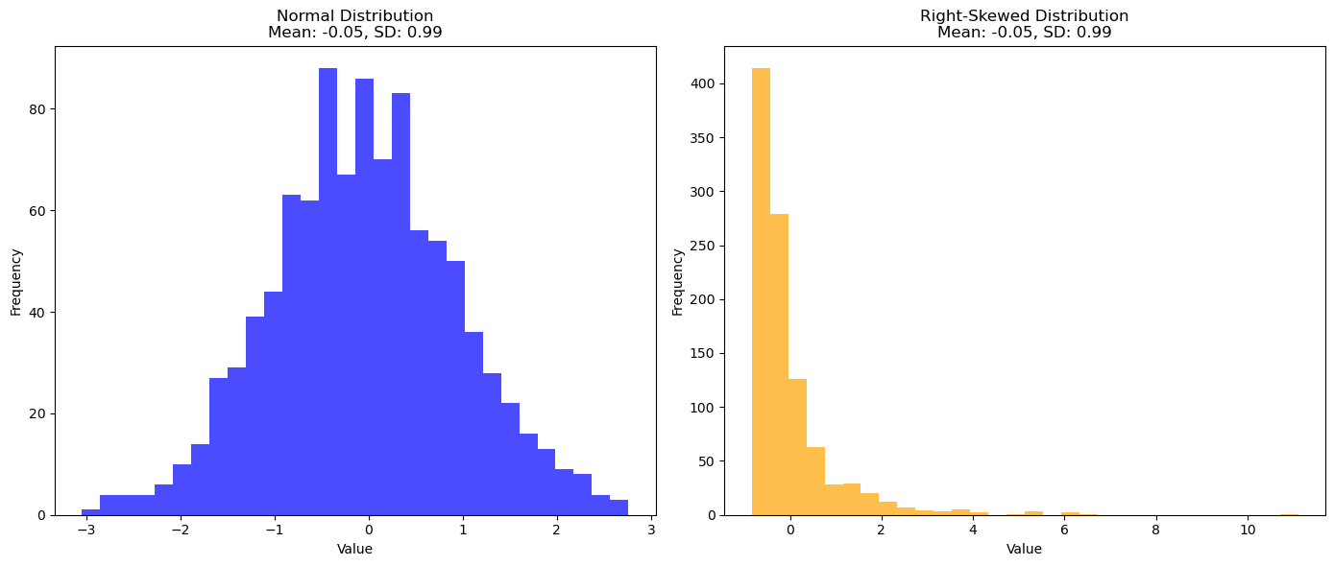
Importance of Skewness
Is it possible that two distributions have the same mean and standard deviations, but they are not similar in distribution? How?
420-TT3-UM - Data Visualization and Reporting Tool | Montreal College IT

Slide 54
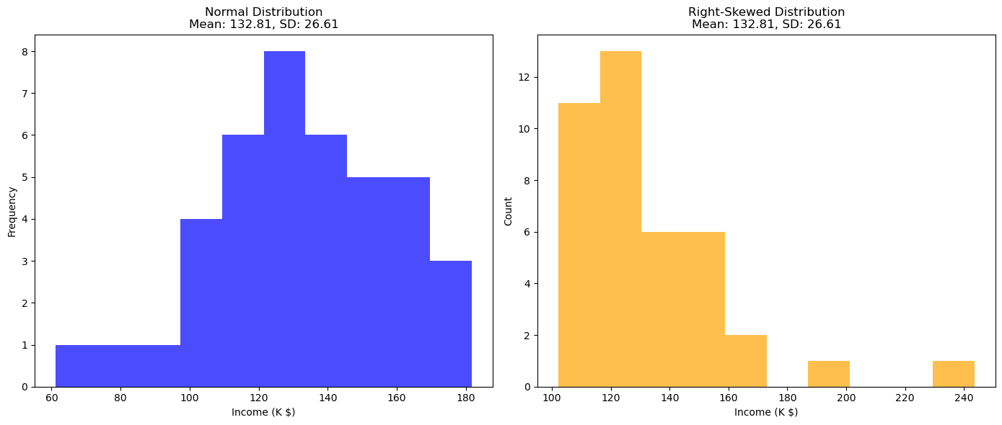
Importance of Skewness
Why is Skewness important?
Example: Income distribution is often skewed, affecting economic policies. A right-skewed income distribution might indicate a large proportion of the population earning below the mean income, which has implications for welfare and taxation policies.
420-TT3-UM - Data Visualization and Reporting Tool | Montreal College IT

Slide 55
Importance of Skewness
It is crucial to consider the differences in shape and spread of two data sets that have the same mean and standard deviation.
Misleading summary statistics
Consider an investment portfolio. Two portfolios may have the same average return (mean) and risk (standard deviation), but one might have consistent returns, while the other might have highly variable returns with occasional large gains or losses. Without understanding the shape of the return distribution, an investor might make an uninformed choice.
Impact on decision making
In healthcare, suppose two treatments have the same average effectiveness (mean) and variability (SD). However, one treatment could have a right-skewed distribution, indicating that it is highly effective for some but less so for many. The other might have a normal distribution, offering moderate effectiveness uniformly.
420-TT3-UM - Data Visualization and Reporting Tool | Montreal College IT

Slide 56
Importance of Skewness
It is crucial to consider the differences in shape and spread of two data sets that have the same mean and standard deviation.
Applicability of statistical tests
In psychology, tests like t-tests assume normal distribution. If data is skewed, these tests might give inaccurate results. For example, analyzing survey data (like satisfaction scores) might require non-parametric tests if the data is not normally distributed.
420-TT3-UM - Data Visualization and Reporting Tool | Montreal College IT

Slide 57
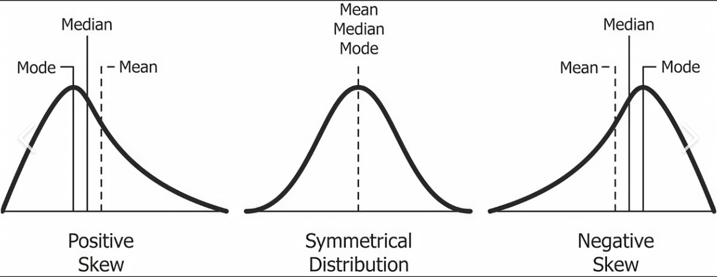
Skewness Takeaways
420-TT3-UM - Data Visualization and Reporting Tool | Montreal College IT

Slide 58
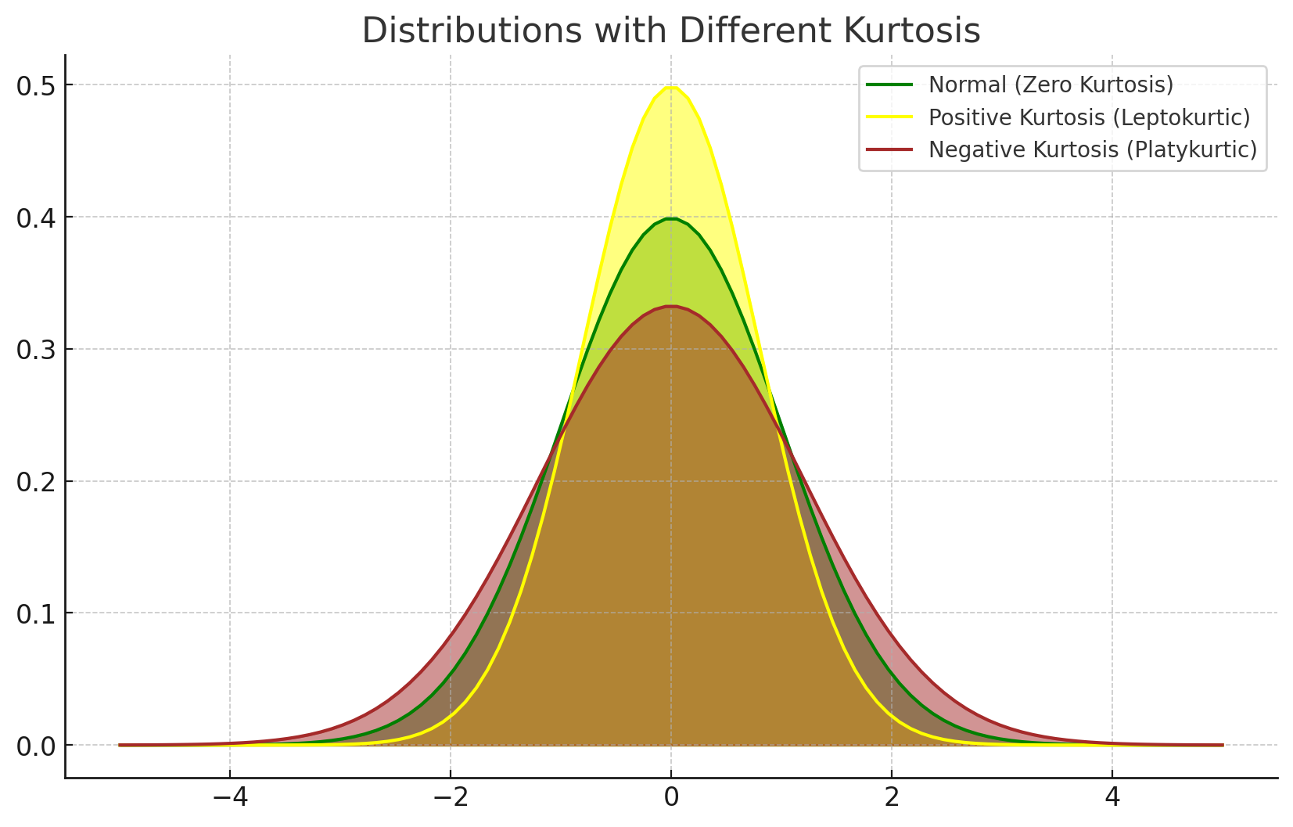
Kurtosis
Kurtosis refers to the degree of flatness or peakedness which is measured relative to the peakedness of normal curve.
420-TT3-UM - Data Visualization and Reporting Tool | Montreal College IT

Slide 59
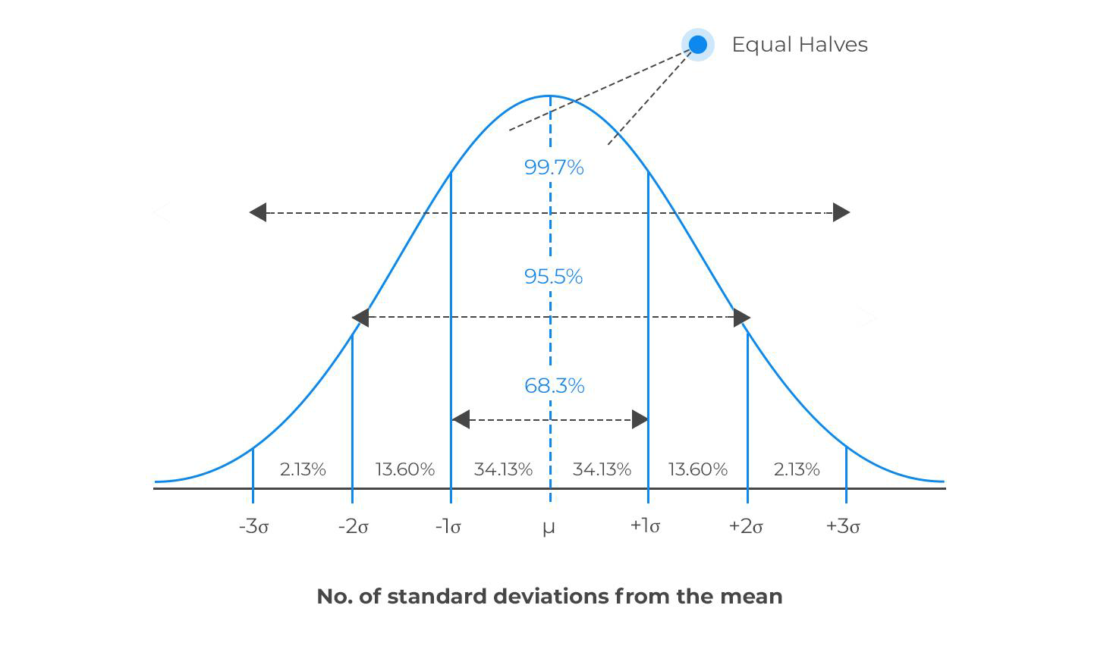
Normal Distribution
The normal distribution, or Gaussian distribution, is one of the most important and widely used probability distributions in statistics and probability theory.
The normal distribution is used in various applications because it approximates the distribution of many naturally occurring phenomena, such as heights, test scores, measurement errors, and IQ scores.
It is also fundamental in statistical hypothesis testing, confidence interval estimation, and data analysis.
420-TT3-UM - Data Visualization and Reporting Tool | Montreal College IT

Slide 60
Normal Distribution Characteristics
Key characteristics of the normal distribution are:
Symmetry: The normal distribution is symmetric around its mean (average). This means that the curve is perfectly balanced, and the mean, median, and mode of the distribution are all equal and located at the centerof the curve.
Bell-shaped: The normal distribution curve is bell-shaped, with the highest point (the peak) occurring at the mean.
Continuous: The normal distribution is a continuous probability distribution, meaning it can take any real value within its range.
Parameters: The normal distribution is fully characterized by two parameters: the mean (μ) and the standard deviation (σ).
Empirical Rule: The normal distribution follows the empirical rule, also known as the 68-95-99.7 rule, which states that approximately 68% of the data falls within one standard deviation of the mean, 95% falls within two standard deviations, and 99.7% falls within three standard deviations.
420-TT3-UM - Data Visualization and Reporting Tool | Montreal College IT

Slide 61
Descriptive Statistics
Descriptive statistics involve summarizing and organizing and simplifying data in a way that provides meaningful information about a sample or population.
Types of Descriptive statistics:
Organizing Data
Tables
Graphs (Bar Charts, Histograms, Line Graphs, Pie Charts, Scatter Plots, Box Plots)
2. Summarizing Data
Measures of Central Tendency (Mean, Median, mode)
Measures of Variation (Range, Interquartile Range, Variance, Standard Deviation)
Measures of Shape (Skewness, Kurtosis)
Measures of Association (Covariance, Correlation)
420-TT3-UM - Data Visualization and Reporting Tool | Montreal College IT

Slide 62
Summarizing Data
d. Measures of Association
So far, we have been analyzing summary statistics that describe aspects of a single list of numbers. Frequently, however, we are interested in how variables behave together.
Covariance and Correlation are statistical tools used to measure the relationship between two variables.
They help us understand whether variables move together or in opposite directions.
420-TT3-UM - Data Visualization and Reporting Tool | Montreal College IT

Slide 63

Covariance
Covariance is a measure that indicates the extent to which two variables change together.
A positive value means that if one variable increases, the other tends to increase as well. A negative value indicates the opposite. The covariance values range from -∞ to +∞.
Example: Ice cream sales and temperature. As temperature increases (hotter days), ice cream sales increase, indicating a positive covariance.
420-TT3-UM - Data Visualization and Reporting Tool | Montreal College IT

Slide 64
Covariance
Covariance values are not standardized and can range from negative to positive infinity.
Because of this, it's hard to understand the strength of the relationship from covariance alone.
420-TT3-UM - Data Visualization and Reporting Tool | Montreal College IT

Slide 65
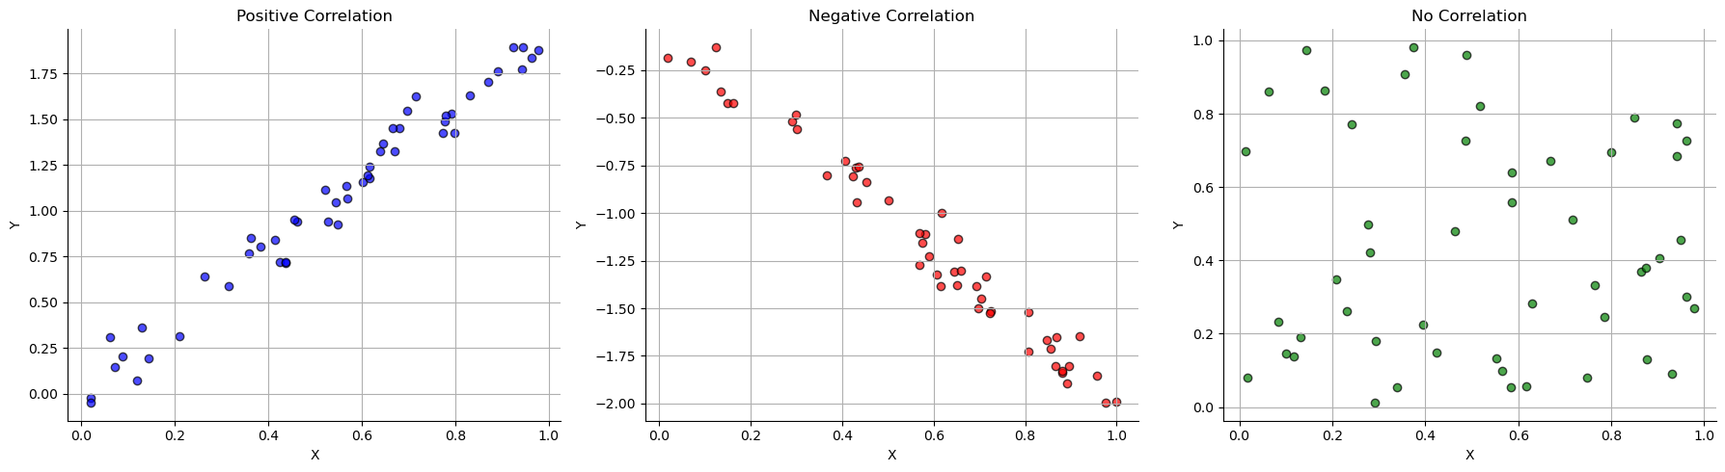
Correlation
Correlation also measures the strength and direction of the relationship between two variables.
Unlike covariance, correlation values are standardized between -1 and 1.
A correlation of 1 means a perfect positive relationship, -1 means a perfect negative relationship, and 0 means no relationship.
420-TT3-UM - Data Visualization and Reporting Tool | Montreal College IT

Slide 66
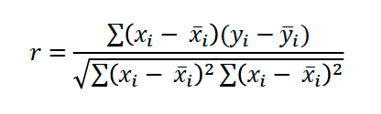
Correlation
Think of correlation as a standardized score that tells you if variables like to move together, in opposite directions, or act independently of each other.
Example: Studying and grades. Generally, as studying increases, grades tend to increase, suggesting a positive correlation.
To measure correlation, we can calculate the Pearson Correlation Coefficient.
420-TT3-UM - Data Visualization and Reporting Tool | Montreal College IT

Slide 67
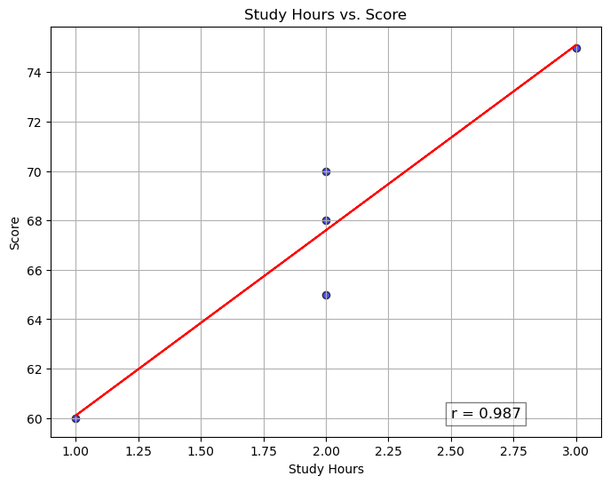
Pearson Correlation Coefficient
Study Hours | Score
2 | 65
3 | 75
1 | 60
4 | 85
2 | 70
5 | 90
3 | 75
4 | 80
2 | 68
6 | 95
r = | 0.987
Example:
420-TT3-UM - Data Visualization and Reporting Tool | Montreal College IT

Slide 68
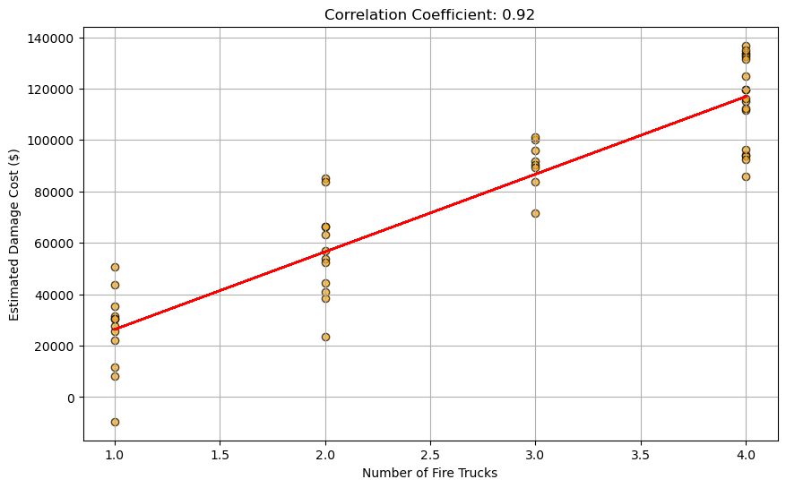
Correlation and Causation
Just because two variables are correlated does not mean one causes the other to happen.
Example: The number of fire trucks at a scene and the damage caused by the fire are correlated, but more fire trucks do not cause more damage.
Note: To model this relationship, we need regression.
420-TT3-UM - Data Visualization and Reporting Tool | Montreal College IT

Slide 69
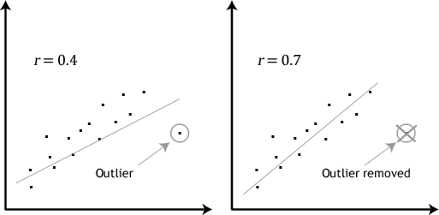
Correlation and Outliers
Correlation is sensitive to outliers.
We need to manage outliers before correlation calculation.
420-TT3-UM - Data Visualization and Reporting Tool | Montreal College IT

Slide 70
Types of Correlation
We have other correlation, depending on the dataset and analysis:
Correlation | Feature | Example
Pearson | Numerical vs. Numerical | Age and blood pressure
Spearman | At least one of the variable is categorical | IQ and TV viewing hours
Kendall | At least one of the variable is categorical | Customer satisfaction and employee training level
420-TT3-UM - Data Visualization and Reporting Tool | Montreal College IT

Slide 71
Descriptive Statistics
Descriptive statistics involve summarizing and organizing and simplifying data in a way that provides meaningful information about a sample or population.
Types of Descriptive statistics:
Organizing Data
Tables
Graphs (Bar Charts, Histograms, Line Graphs, Pie Charts, Scatter Plots, Box Plots)
2. Summarizing Data
Measures of Central Tendency (Mean, Median, mode)
Measures of Variation (Range, Interquartile Range, Variance, Standard Deviation)
Measures of Shape (Skewness, Kurtosis)
Measures of Association (Covariance, Correlation)
420-TT3-UM - Data Visualization and Reporting Tool | Montreal College IT

Slide 72
Regression
Regression is a statistical method used to model the relationship between a dependent variable (often denoted as "Y") and one or more independent variables (often denoted as "X").
It aims to understand how changes in the independent variable(s) affect the dependent variable.
Many types of relationships can be modeled with regression:
Simple linear regression
Multiple linear regression
Polynomial regression
Logistic Regression
420-TT3-UM - Data Visualization and Reporting Tool | Montreal College IT

Slide 73
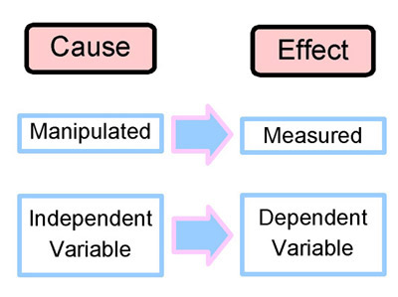
Dependent and Independent Variables
Independent variables:
The independent variable is the "cause" or "manipulated factor."
Example: Study hours in our example.
Dependent variables:
The dependent variable is the variable being studied or measured in an experiment or analysis (" Effect”).
Example: Exam scores in our example.
420-TT3-UM - Data Visualization and Reporting Tool | Montreal College IT

Slide 74
Simple Linear Regression
Simple linear regression is one of the most common types of regression.
In simple linear regression, there is one independent variable, and the relationship between variables is represented by a straight line (linear equation).
In simple linear regression, we try to model the following relationship:
𝑦=𝑎𝑥+𝑏
a: slope of the line
b: the y-intercept
420-TT3-UM - Data Visualization and Reporting Tool | Montreal College IT

Slide 75
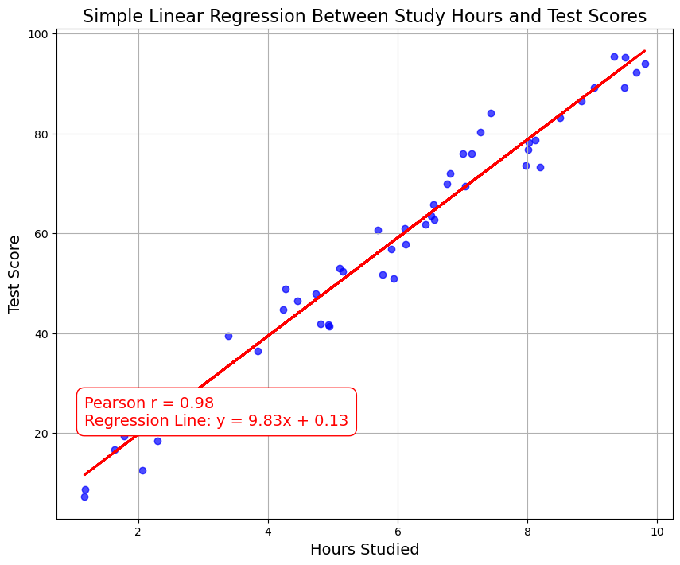
Simple Linear Regression
Example:
Simple Linear Regression between Study hours and Test scores
What are independent and dependent variables?
420-TT3-UM - Data Visualization and Reporting Tool | Montreal College IT

Slide 76
Correlation vs. Regression
 | Correlation | Simple Linear Regression
Purpose | Measure the strength and direction of the linear relationship between two continuous variables. | Model and predict the dependent variable (Y) based on the independent variable (X) in a linear relationship.
Type of Variables | Requires two continuous variables (X and Y). | Requires two continuous variables (X and Y).
Range of Values | Ranges from -1 to 1. | Coefficient (slope) can range from negative infinity to positive infinity.
Equation | No specific equation; measures correlation coefficient (r). | Uses a linear equation (Y = a + bX) to model the relationship.
Causation Inference | Correlation does not imply causation; it only quantifies association. | Regression can be used for causal inference when certain conditions are met, but it does not prove causation.
420-TT3-UM - Data Visualization and Reporting Tool | Montreal College IT

Slide 77
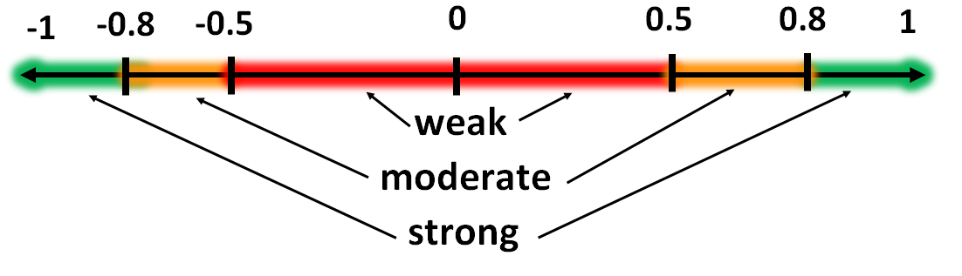
Correlation Recap
Correlation is a way to quantify the strength between two or more variables-how close two variables are to having a linear relationship with each other.
The presence of a correlation is not sufficient to infer the presence of a causal relationship (i.e. correlation does not imply causation).
The most widely used measure of correlation is the Pearson correlation coefficient which measures the linear correlation between two variables X and Y and has a value between +1 and -1.
A correlation coefficient of +1 indicates a perfect positive linear relationship, and a correlation coefficient of -1 indicates a perfect negative relationship.
420-TT3-UM - Data Visualization and Reporting Tool | Montreal College IT

Slide 78
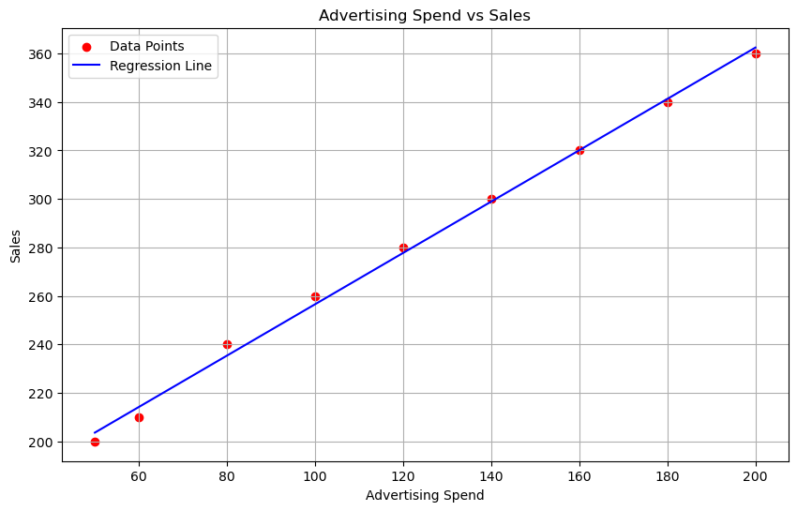
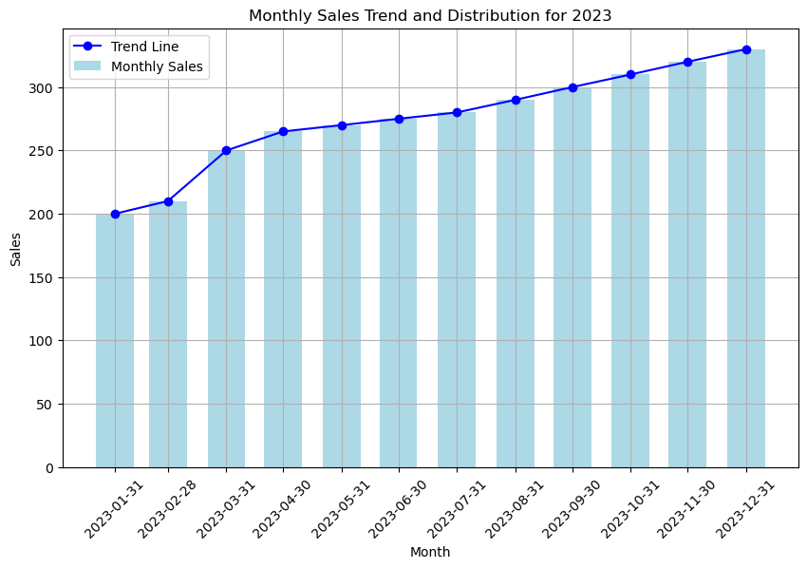
Regression vs. Trend
Regression line is a statistics concept where we try to explain the dependent variables based on variation in independent variables for a given set of data points.
Regression is a relationship between two variables.
Trend line is a straight line indicating the direction of a process with respect to time.
Trend is a time series concept . Trend says whether over time data is in uptrend or down-trend.
420-TT3-UM - Data Visualization and Reporting Tool | Montreal College IT

Slide 79
Standardization
Most data sets contain diverse information. The variables are typically displayed in several dimensions.
Consider the data set on the right, which contains the following variables:
Age (in years)
Annual income (in US$)
Height (in cm)
The income column has the highest range.
Age (years) | Income (US$) | Height (cm)
28 | 50000 | 175
35 | 60000 | 180
42 | 75000 | 168
31 | 55000 | 172
45 | 80000 | 185
29 | 52000 | 170
38 | 68000 | 176
33 | 62000 | 178
40 | 72000 | 173
27 | 48000 | 168
420-TT3-UM - Data Visualization and Reporting Tool | Montreal College IT

Slide 80
The Objective of Standardization
Standardization ensures that data is presented in a uniform format, making it consistent and easy to compare and analyze.
It enables data from different sources to be integrated seamlessly, allowing for more comprehensive analysis and collaboration across systems.
Age (years) | Income (US$) | Height (cm)
28 | 50000 | 175
35 | 60000 | 180
42 | 75000 | 168
31 | 55000 | 172
45 | 80000 | 185
29 | 52000 | 170
38 | 68000 | 176
33 | 62000 | 178
40 | 72000 | 173
27 | 48000 | 168
Age (years) | Income (US$) | Height (cm)
-1.088 | -1.093 | 0.092
0.032 | -0.197 | 1.007
1.152 | 1.147 | -1.190
-0.608 | -0.645 | -0.458
1.632 | 1.594 | 1.922
-0.928 | -0.914 | -0.824
0.512 | 0.520 | 0.275
-0.288 | -0.018 | 0.641
0.832 | 0.878 | -0.275
-1.248 | -1.272 | -1.190
420-TT3-UM - Data Visualization and Reporting Tool | Montreal College IT

Slide 81
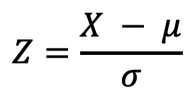
How Does Standardization Work?
Calculate Mean and Standard Deviation: First, calculate the mean and standard deviation of the column (or field or feature or variable or attribute) you want to standardize.
Subtract the Mean: For each data point, subtract the mean value from it.
Divide by Standard Deviation: After subtracting the mean, divide each data point by the standard deviation.
Resulting Z-Scores: The values you obtain after these calculations are called Z-scores or standard scores.
$$Z=\frac{X − μ}{σ}$$
420-TT3-UM - Data Visualization and Reporting Tool | Montreal College IT

Slide 82
Example of Standardization
Step 1: Calculate mean and Std. for each field
Age (years) | Income (US$) | Height (cm)
28 | 50000 | 175
35 | 60000 | 180
42 | 75000 | 168
31 | 55000 | 172
45 | 80000 | 185
29 | 52000 | 170
38 | 68000 | 176
33 | 62000 | 178
40 | 72000 | 173
27 | 48000 | 168
Age (years) | Income (US$) | Height (cm)
28 | 50000 | 175
35 | 60000 | 180
42 | 75000 | 168
31 | 55000 | 172
45 | 80000 | 185
29 | 52000 | 170
38 | 68000 | 176
33 | 62000 | 178
40 | 72000 | 173
27 | 48000 | 168
34.80 | 62200.00 | 174.50
6.25 | 11163.43 | 5.46
Step 1
Mean
Std. Dev
420-TT3-UM - Data Visualization and Reporting Tool | Montreal College IT

Slide 83
Example of Standardization
Step 2: Subtract Mean from each data point
Age (years) | Income (US$) | Height (cm)
28 | 50000 | 175
35 | 60000 | 180
42 | 75000 | 168
31 | 55000 | 172
45 | 80000 | 185
29 | 52000 | 170
38 | 68000 | 176
33 | 62000 | 178
40 | 72000 | 173
27 | 48000 | 168
34.80 | 62200.00 | 174.50
6.25 | 11163.43 | 5.46
Age (years) | Income (US$) | Height (cm)
-6.80 | -12200.00 | 0.50
0.20 | -2200.00 | 5.50
7.20 | 12800.00 | -6.50
-3.80 | -7200.00 | -2.50
10.20 | 17800.00 | 10.50
-5.80 | -10200.00 | -4.50
3.20 | 5800.00 | 1.50
-1.80 | -200.00 | 3.50
5.20 | 9800.00 | -1.50
-7.80 | -14200.00 | -6.50
0.00 | 0.00 | 0.00
6.25 | 11163.43 | 5.46
Step 2
420-TT3-UM - Data Visualization and Reporting Tool | Montreal College IT

Slide 84
Example of Standardization
Step 3: Divide each data point by Std.
Age (years) | Income (US$) | Height (cm)
-6.80 | -12200.00 | 0.50
0.20 | -2200.00 | 5.50
7.20 | 12800.00 | -6.50
-3.80 | -7200.00 | -2.50
10.20 | 17800.00 | 10.50
-5.80 | -10200.00 | -4.50
3.20 | 5800.00 | 1.50
-1.80 | -200.00 | 3.50
5.20 | 9800.00 | -1.50
-7.80 | -14200.00 | -6.50
0.00 | 0.00 | 0.00
6.25 | 11163.43 | 5.46
Age (years) | Income (US$) | Height (cm)
-1.088 | -1.093 | 0.092
0.032 | -0.197 | 1.007
1.152 | 1.147 | -1.190
-0.608 | -0.645 | -0.458
1.632 | 1.594 | 1.922
-0.928 | -0.914 | -0.824
0.512 | 0.520 | 0.275
-0.288 | -0.018 | 0.641
0.832 | 0.878 | -0.275
-1.248 | -1.272 | -1.190
0.00 | 0.00 | 0.00
1.00 | 1.00 | 1.00
Step 3
Standardized values or
Z-scores
420-TT3-UM - Data Visualization and Reporting Tool | Montreal College IT

Slide 85
Interpreting the Z-Scores
Key benefits of using standardization:
Consistency: Standardization ensures that data is presented in a uniform format.
Interoperability: It enables seamless integration of data from different sources.
Data Accuracy: Standardization reduces errors and inaccuracies arising from varying units or formats.
Efficiency: Standardized data streamlines data preparation.
Age (years) | Income (US$) | Height (cm)
-1.088 | -1.093 | 0.092
0.032 | -0.197 | 1.007
1.152 | 1.147 | -1.190
-0.608 | -0.645 | -0.458
1.632 | 1.594 | 1.922
-0.928 | -0.914 | -0.824
0.512 | 0.520 | 0.275
-0.288 | -0.018 | 0.641
0.832 | 0.878 | -0.275
-1.248 | -1.272 | -1.190
0.00 | 0.00 | 0.00
1.00 | 1.00 | 1.00
420-TT3-UM - Data Visualization and Reporting Tool | Montreal College IT

Slide 86
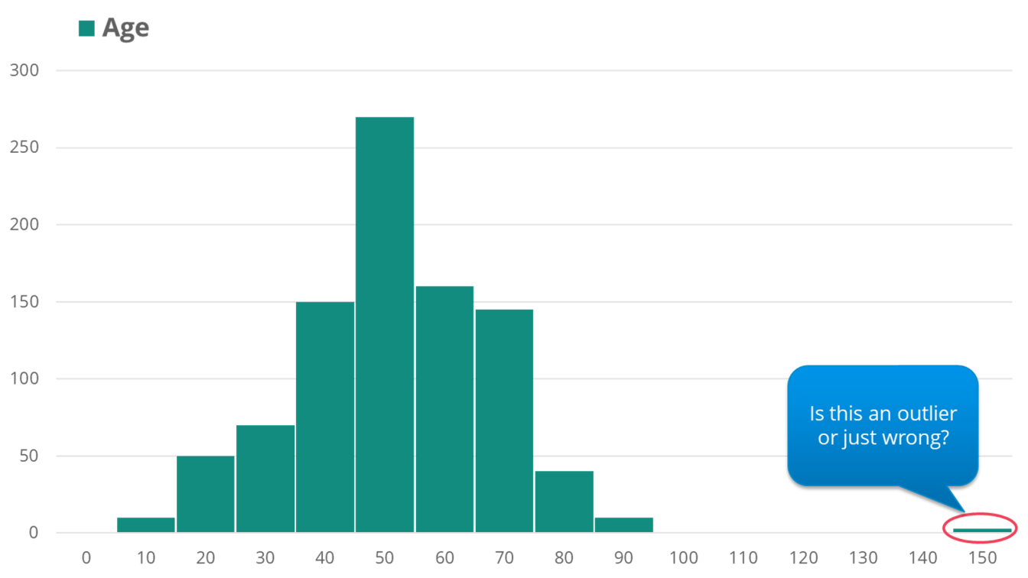
Outlier Detection
Outliers are data points significantly different from the rest of the dataset. They can be exceptionally high or low values or data points that exhibit unusual patterns.
Detecting outliers is crucial because they can distort statistical analyses, machine learning models, and data visualization.
420-TT3-UM - Data Visualization and Reporting Tool | Montreal College IT

Slide 87
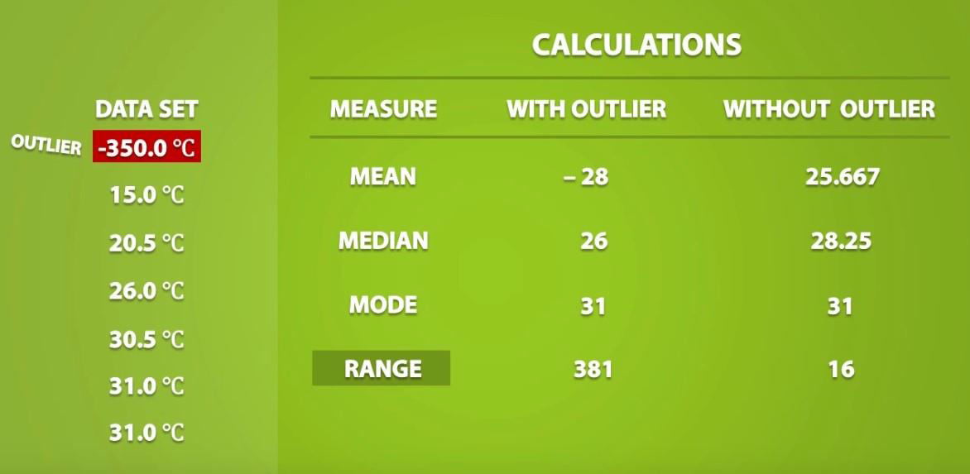
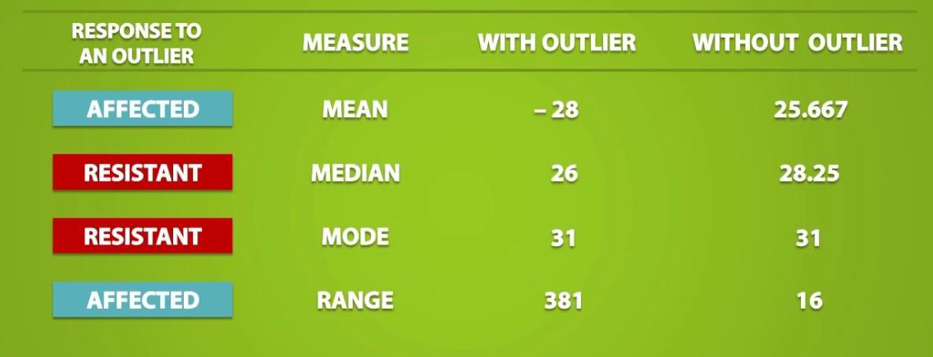
Outlier Detection
420-TT3-UM - Data Visualization and Reporting Tool | Montreal College IT

Slide 88
Outlier Detection Methods
There are different ways to detect outliers in data sets:
Statistical Approaches
Z-Score
IQR
2. Machine Learning Algorithms
Isolation Forests
One-Class SVM
3. Visual Techniques
Scatter Plots
Box Plots
420-TT3-UM - Data Visualization and Reporting Tool | Montreal College IT

Slide 89
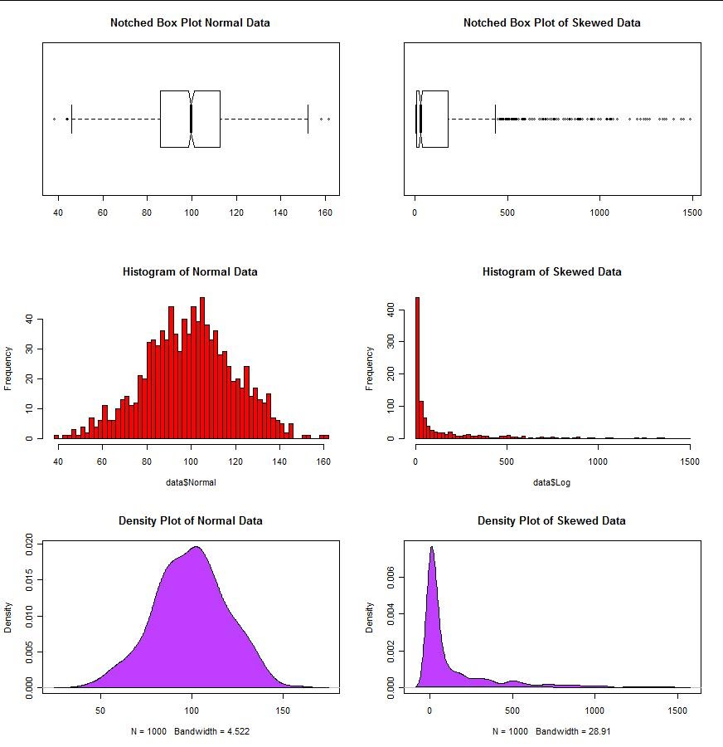
Outlier Detection Methods (Box plot)
A box plot displays the summary of a set of data values having properties like minimum, first quartile, median, third quartile, and maximum.
Outliers in a box plot are typically indicated by points that lie outside the whiskers, which are 1.5 times the interquartile range (IQR) from the lower and upper quartiles.
420-TT3-UM - Data Visualization and Reporting Tool | Montreal College IT

Slide 90
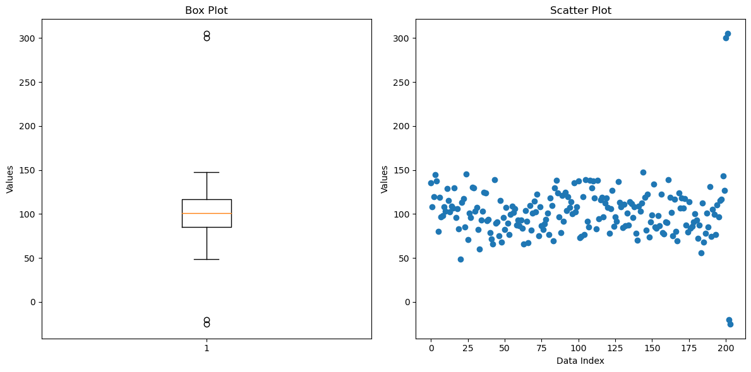
Outlier Detection Methods (Scatter plot)
A scatter plot shows all individual data points on a two-dimensional graph, making it easy to spot where the points cluster and where they do not.
Outliers in a scatter plot are points that are significantly distant from the main cluster of data. They don’t follow the trend set by the majority of the points.
420-TT3-UM - Data Visualization and Reporting Tool | Montreal College IT

Slide 91
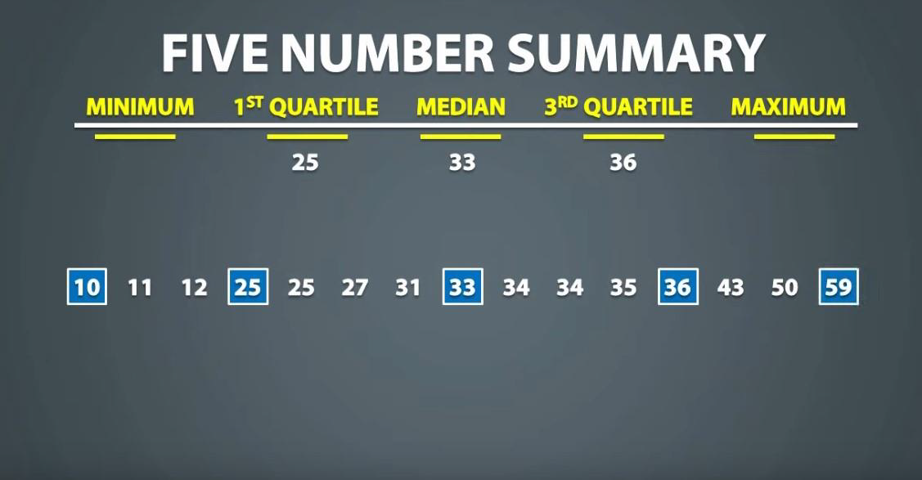
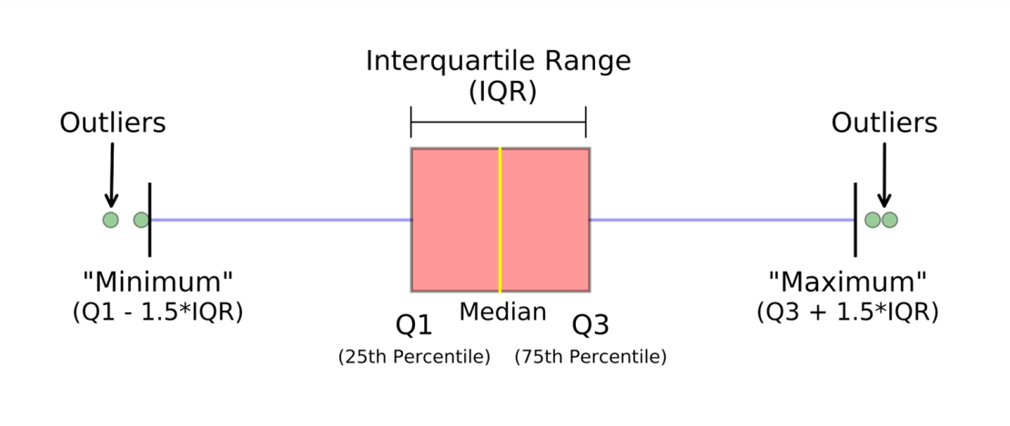
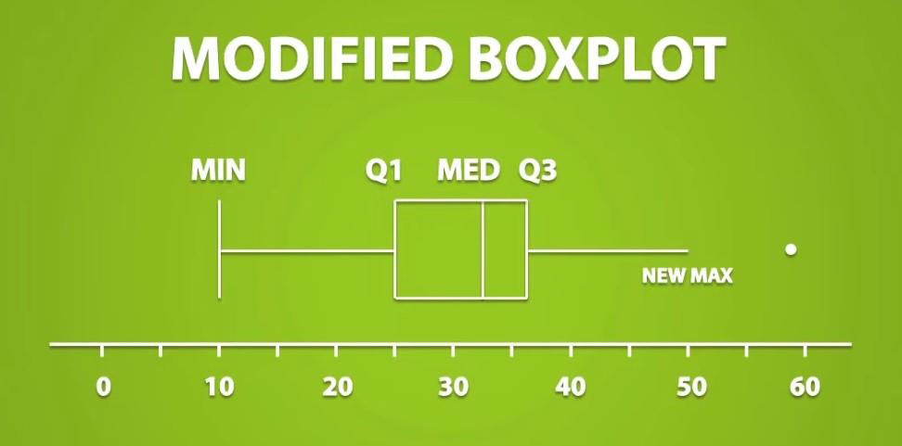
Outlier Detection Methods (IQR)
420-TT3-UM - Data Visualization and Reporting Tool | Montreal College IT

Slide 92
Outlier Detection Methods (IQR)
Outliers are typically defined as observations that fall below Q1 – (1.5 * IQR) or above
Q3 + (1.5 * IQR).
420-TT3-UM - Data Visualization and Reporting Tool | Montreal College IT

Slide 93
Outlier Detection Methods (Z-Score)
The Z-score tells you how many standard deviations a data point is from the mean.
A common threshold for identifying outliers is a Z-score of 1.96 or 2, which corresponds to the 95th percentile and 97.5th percentile, respectively, in a normal distribution.
Data points with a Z-score greater than 2 or less than -2 are often considered outliers.
import numpy as np
# Example data
data = np.array([10, 12, 13, 12, 11, 14, 13, 15, 102, 14, 13, 12, 10, 100])
# Calculate mean and standard deviation
mean = np.mean(data)
std_dev = np.std(data)
# Calculate Z-scores
z_scores = (data - mean) / std_dev
# Identify outliers
outliers = data[np.abs(z_scores) > 2]
420-TT3-UM - Data Visualization and Reporting Tool | Montreal College IT

Slide 94
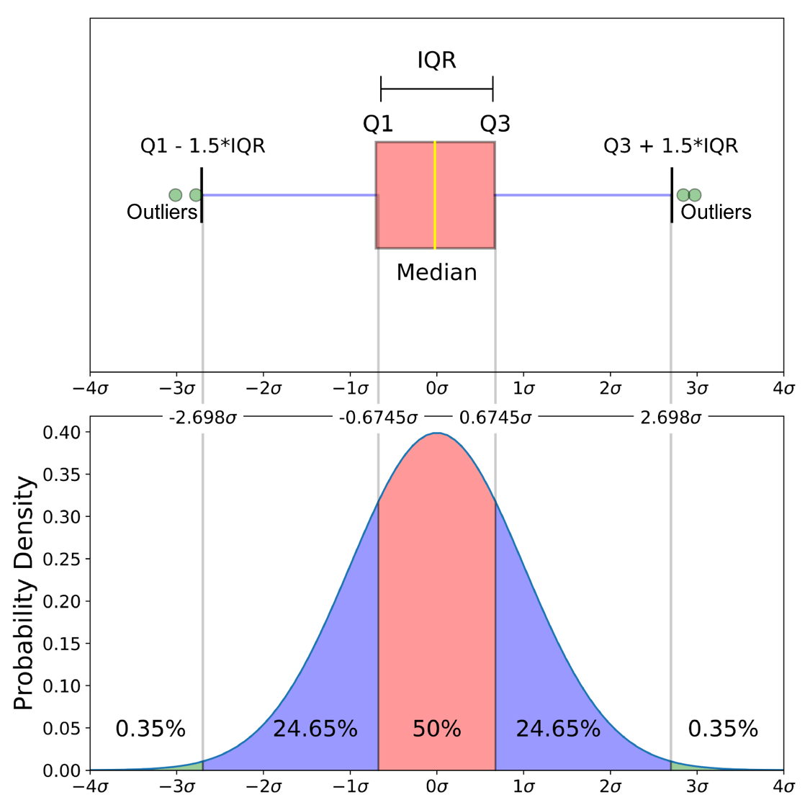
Normal Distribution and Box Plot
What do you understand from this?
420-TT3-UM - Data Visualization and Reporting Tool | Montreal College IT

Slide 95

Outlier Detection Challenges
Identifying outliers can be challenging because what constitutes an outlier may vary depending on the context.
Domain knowledge and a clear understanding of the dataset are often required to determine the appropriate handling of outliers, whether through removal, transformation, or further investigation.
420-TT3-UM - Data Visualization and Reporting Tool | Montreal College IT

Slide 96
Outlier Detection Use Cases
Outlier detection is widely used in various domains, including:
In finance, outlier detection is used for fraud detection.
In healthcare, outlier detection is used to find diseases.
In manufacturing, outlier detection is used for quality control.
In data analysis, outlier detection can be used as a pre-processing step to increase the quality of data sets.
420-TT3-UM - Data Visualization and Reporting Tool | Montreal College IT

Slide 97

Dealing With Missing Values
Missing values (denoted by NA) are one of the most common ‘flaws’ in data sets, and they are important because they might have a large impact onthe functions and formulas that you aim to use(especially in the models that are discussed in the next chapter)
Some functions have been set up to deal with missing values, whereas other functions might return errors when they need to deal with NAs.
420-TT3-UM - Data Visualization and Reporting Tool | Montreal College IT

Slide 98
Missing Values - Techniques
1. Deletion (Drop) Methods: Eliminate any row that has a missing value.
Suitable if there are only a limited number of NAs, and the data set is large enough that reducing the size has little impact on the overall results.
2. Imputation Methods: Filling in missing values with some estimated or calculated values.
Suitable if you want to keep all your observations. This will not skew the data too much because it ‘smoothens’ the observations. However, the results might become dependent on order of the rows.
Examples: constant values, mean/median/mode, forward or backward filling.
3. Model-Based Methods: Utilize certain machine learning algorithms that can inherently handle missing values.
Suitable if you are applying particular algorithms where they accurately predict missing values based on other features, especially in smaller datasets.
Examples: XGBoost, Decision Trees, Neural Networks with Data Imputation Layers
420-TT3-UM - Data Visualization and Reporting Tool | Montreal College IT

Slide 99
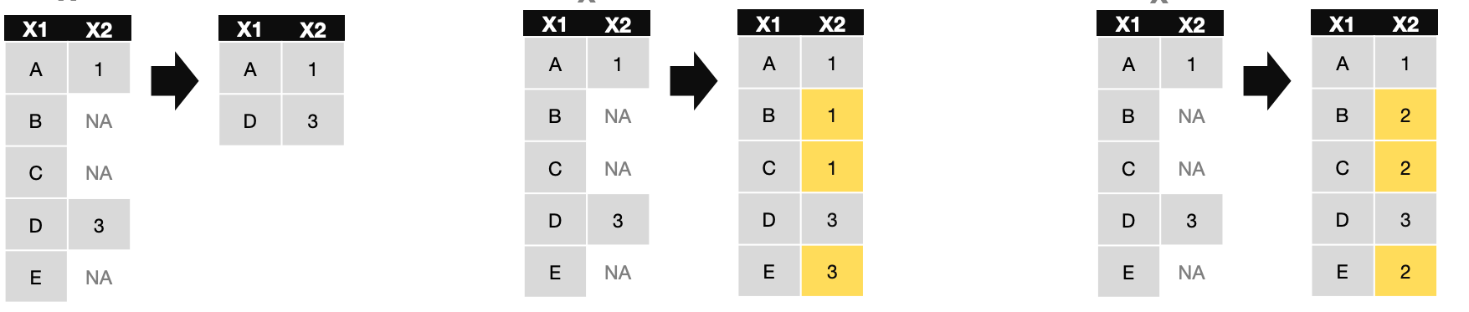
Missing Values - Examples
Drop
Fill
Replace
420-TT3-UM - Data Visualization and Reporting Tool | Montreal College IT

Slide 100

More on Box Plot and IQR
A box plot uses minimum, first quartile (Q1), median (Q2), third quartile (Q3), and maximum.
It visualizes the central tendency, spread, and skewness of the data and highlights potential outliers.
Box plots are particularly useful for comparing distributions between several groups or datasets and are a staple in exploratory data analysis (EDA).
420-TT3-UM - Data Visualization and Reporting Tool | Montreal College IT

Slide 101

More on Box Plot, IQR and its Pitfalls
In the context of a box plot, the minimum and maximum typically refer to the smallest and largest values within 1.5 * IQR from the quartiles. The whiskers of the box plot often represent these.
The minimum is usually set at (Q1 - 1.5 * IQR), and the maximum is set at (Q3 + 1.5 * IQR). These limits are not the absolute smallest and largest values but are thresholds for what is considered normal variation in the data.
Data points that fall outside the range of the whiskers are considered outliers and are often marked with dots.
420-TT3-UM - Data Visualization and Reporting Tool | Montreal College IT

Slide 102
More on Box Plot, IQR and Outlier Detection in Coding and Excel
The absolute smallest and largest data points can sometimes be outside these thresholds and are thus marked as outliers.
The box plot focuses on the spread of the bulk of the data. It uses the IQR to gauge what is typical or atypical, hence using calculated minimum and maximum values instead of the absolute extremes.
The protocol of using the 1.5 * IQR to determine the whiskers and identify outliers (marks data points outside this range as outliers) in a box plot is a standard approach and is commonly used across various libraries and tools, including
Matplotlib (Python)
Seaborn (Python)
R (ggplot2, Base R)
Other Statistical Software (e.g., SPSS, SAS)
Excel
420-TT3-UM - Data Visualization and Reporting Tool | Montreal College IT

Slide 103

More on Box Plot
Income (US$)
30,000 | 90,000
55,000 | 95,000
56,000 | 155,000
57,000 | 200,000
58,000
59,000
63,000
63,000
65,000
65,000
67,000
69,000
71,000
72,000
74,000
80,000
85,000
Example:
For the given dataset of income (US$), plot the box plot in Excel, and determine the following:
Absolute min and max
Outlier(s)
420-TT3-UM - Data Visualization and Reporting Tool | Montreal College IT

Slide 104


Standardization vs. Normalization
Standardization (also called Z-Score Normalization) and Normalization (also called Min-Max Scaling) are both techniques used to scale features in data preprocessing, but they work differently and are used in different scenarios. In practice, it's common to try both methods and determine which one gives better results for your specific application.
Standardization
$$Z=\frac{X −mean(X)}{std(X)}$$
Standardization rescales data with a mean of 0 and a standard deviation of 1.
This process does not bind values to a specific range.
It is necessary if we are comparing measurements that have different units, but it is also a general requirement for many machine learning algorithms that assume data to be normally distributed.
Normalization
$$Xnorm=\frac{X −min(X)}{max\left(X\right)−min(X)}$$
The data is scaled to a fixed range (usually 0 to 1).
Normalization is often used when the algorithm does not assume any distribution of the data, like in neural networks and k-nearest neighbors (distance-based algorithms).
Which one is more sensitive to outliers?
420-TT3-UM - Data Visualization and Reporting Tool | Montreal College IT

Slide 105

Standardization vs. Normalization
Example:
Age | Salary
44 | 72000
27 | 48000
30 | 54000
38 | 61000
40 | -
35 | 58000
- | 52000
48 | 79000
50 | 83000
37 | 67000
420-TT3-UM - Data Visualization and Reporting Tool | Montreal College IT

Slide 106

Probability
In Data Science, Probability forms the backbone of our ability to make informed decisions. It allows us to quantify uncertainty, enabling predictions about data trends and behaviors.
In Data Science, we use probability to quantify the uncertainty in data and forecasts. This quantification is crucial for developing models that can predict future events or trends based on historical data.
420-TT3-UM - Data Visualization and Reporting Tool | Montreal College IT

Slide 107
Probability
Probability theory is nothing, but common sense reduced to calculation.
Pierre Laplace (1812)
The probability that a (fair) coin will land heads is 50%. But what does this mean?
There are two different interpretations of probability:
Frequentist interpretation (probabilities represent long run frequencies of events that can happen multiple times): if we flip the coin many many times, we expect it to land heads about half the time.
Bayesian interpretation (probability is used to quantify our uncertainty or ignorance about something rather than repeated): the coin is equally likely to land heads or tails on the next toss (uncertainty regarding a single event's outcome based on current knowledge).
420-TT3-UM - Data Visualization and Reporting Tool | Montreal College IT

Slide 108
Probability
Another Example: Predicting Rain
Frequentist Interpretation:
In this view, the probability of rain is based on the long-run frequency of rainy days. Let’s say you look at historical weather data for the city and find that, over many years, it has rained on 30% of the days. The Frequentist would say that the probability of rain tomorrow is 30%, based on this long-term frequency. This interpretation relies solely on the empirical data of past occurrences and does not take into account any other information (such as current weather patterns or forecasts).
Bayesian Interpretation:
The Bayesian approach considers the probability of rain as a measure of belief or certainty, which can be updated as new information becomes available. Initially, you might start with the historical frequency (30% chance of rain) as your prior belief. However, if you have additional information, like a weather forecast predicting a strong storm system approaching the city, you will update your belief. In this case, you might revise the probability upward, say to 80%, reflecting your updated belief based on the new evidence. The Bayesian interpretation is flexible and allows for the incorporation of new evidence to adjust the probability.
420-TT3-UM - Data Visualization and Reporting Tool | Montreal College IT

Slide 109



Calculating Probability
Probability is calculated by using this formula:
Probability = $\frac{Desired Outcome}{Possible Outcome}$
Probability of flipping head:
Desired outcome = flipping head (1 outcome)
Possible outcome = head and tail (2 outcome)
Probability = $\frac{1}{2}$ = 0.5 = 50%
Chance of drawing a queen from a deck of cards:
Probability = $\frac{4}{52}$ = 0.077 = 7.7%
420-TT3-UM - Data Visualization and Reporting Tool | Montreal College IT

Slide 110
Calculating Probability
Question: What is the probability of rolling a number greater than 4 on a standard six-sided die?
Question: What is the chance of drawing an Ace from a standard deck of 52 playing cards?
Question: If you flip two coins, what is the probability that both coins will land on tails?
Question: What is the probability of drawing a red card from a standard deck of 52 playing cards?
Answer: 33.33%
Answer: 7.69%
Answer: 25%
Answer: 50%
420-TT3-UM - Data Visualization and Reporting Tool | Montreal College IT

Slide 111

Probability Distribution
Imagine we measure the sales revenue for a business for the past 12 months.
The lowest revenue was $5,500
The highest revenue was $12,000
The 4th, 5th, and 6th months revenue were from $7,000 to $9,000;
The remaining months' revenue were between $9,000 and $11,000.
The plotted histogram shows you how the probabilities of measurements are distributed.
420-TT3-UM - Data Visualization and Reporting Tool | Montreal College IT

Slide 112
Probability Distribution
For instance, there is a high probability that a month's revenue falls somewhere between $9,000 and $11,000, and a low probability ranges lower than $5,500 or greater than $12,000.
420-TT3-UM - Data Visualization and Reporting Tool | Montreal College IT

Slide 113

Probability Distribution
Example:
The probability of picking a rotten apple from a fruit shop.
Remember that probability lies between 0 and 1.
If we plot the probability for each day of the week (let’s call it X), then we will have the probability distribution for each value of X.
420-TT3-UM - Data Visualization and Reporting Tool | Montreal College IT

Slide 114
Inferential Statistics
Descriptive Statistics are used to describe the basic features of the data in a study. They provide simple summaries of the data.
Organizing Data
Tables
Graphs (Bar Charts, Histograms, Line Graphs, Pie Charts, Scatter Plots, Box Plots)
2. Summarizing Data
Measures of Central Tendency (Mean, Median, mode)
Measures of Variation (Range, Interquartile Range, Variance, Standard Deviation)
Measures of Shape (Skewness, Kurtosis)
Measures of Association (Covariance, Correlation)
Inferential Statistics are used to draw conclusions or make inferences about a larger population based on data collected from a sample. This branch of statistics helps us to understand and interpret data and make predictions or decisions. It goes beyond merely describing the data (what we do in descriptive statistics) to making inferences about the population parameters based on sample statistics.
420-TT3-UM - Data Visualization and Reporting Tool | Montreal College IT

Slide 115

Inferential Statistics – P-Value
P-value stands for “probability value”.
It is like a tool that tells you how surprised you should be by the results of your experiment or study. It answers the question, “If I assume there's no special effect or difference, how likely am I to see a result like this just by chance?”
To be more precise, it indicates how likely it is that a result occurred by chance alone.
420-TT3-UM - Data Visualization and Reporting Tool | Montreal College IT

Slide 116
Inferential Statistics – P-Value
Example:
Context: A teacher believes that the average math test score for their class should be around 75 out of 100 (75%). This belief is based on past experience, the difficulty of the test, and the overall performance of students in previous years.
Situation: The class takes a new math test, and to the teacher's surprise, the average score is 85%, significantly higher than the expected 75%.
Understanding P-value: The assumption is that a 75% test score represents the class's true average capability in math. If the P-value is low (commonly, a threshold of 0.05 or 5% is used), it indicates that the observed outcome (here, an 85% average score) is very unlikely to have occurred by random chance alone if the assumption were true.
420-TT3-UM - Data Visualization and Reporting Tool | Montreal College IT

Slide 117
Inferential Statistics – P-Value
Example (continued):
The previous sentence means that if the average math ability of the class is genuinely represented by a 75% test score (the assumption), then obtaining an actual average test score of 85% is so rare or unexpected (as indicated by the low P-value) that it suggests the assumption might be incorrect. In other words, the class's actual math ability might be higher than what the teacher initially thought because such a high score is unlikely to occur just by chance.
Calculating P-value: To find the p-value, the teacher would use statistical methods to calculate the probability of observing an average score of 85% or more, assuming that the class's true average is indeed 75%. This involves considering factors like the number of students, the variation in their scores, and the distribution of test scores under normal circumstances.
420-TT3-UM - Data Visualization and Reporting Tool | Montreal College IT

Slide 118
Inferential Statistics – P-Value
Example (continued):
Conclusion:
If the p-value is low (P-value < 0.05), the teacher might conclude that the class's math skills are likely better than initially thought. The high average score is not just a 'lucky fluke' but potentially indicative of higher-than-expected math ability in the class.
On the other hand, if the p-value is high (P-value > 0.05), the 85% average could reasonably occur due to random variation, even if the true average ability is 75%. Therefore, the teacher might not consider the high score as evidence of the class being exceptionally good in math.
420-TT3-UM - Data Visualization and Reporting Tool | Montreal College IT

Slide 119

420-TT3-UM - Data Visualization and Reporting Tool | Montreal College IT

Slide 120

What is Power BI?
Microsoft Power BI is a tool that helps organize and visualize data from different sources.
Power BI lets you:
connect to data
clean and structure it
create visualizations
share your findings with others
420-TT3-UM - Data Visualization and Reporting Tool | Montreal College IT

Slide 121

What is Power BI?
Visually representing data lets people interpret and analyze data easier and faster.
Example:
It is easier to find the most profitable year in a bar plot than scrolling through a spreadsheet
420-TT3-UM - Data Visualization and Reporting Tool | Montreal College IT

Slide 122


Why Power BI
According to Gartner (2023):
Power BI is the leading BI tool
Over 97% of Fortune 500 companies use Power BI
Power BI has over six million customers worldwide
With so many companies around the world using Power BI learning and mastering this BI tool can help you progress in your data-related career.
420-TT3-UM - Data Visualization and Reporting Tool | Montreal College IT

Slide 123

Parts of Power BI
Power BI consists of:
a Microsoft Windows desktop application called Power BI Desktop
an online SaaS (Software as a Service) service called the Power BI service
mobile Power BI apps that are available on phones and tablets and called Power Bi Mobile apps
Power BI Desktop is free to use, but there is a paid version called Power BI Pro available.
Power BI Pro allows you to publish work on the Power BI Service. It also allows you to collaborate with other Power BI users.
420-TT3-UM - Data Visualization and Reporting Tool | Montreal College IT

Slide 124
Power BI Quiz
1. Power BI helps with which of the following business processes?
Notifying users when a SharePoint list item has changed.
Generating an approval.
Analyzing and displaying data.
2. What can Power BI do to help you effectively use your data?
Analyze sales data to better allocate resources and place orders, optimizing operations.
Analyze customer data to better target and promote specific items to specific customers.
All of the above.
3. What are the three modalities of Power BI designed to let people create, share, and consume business insights in the way that serves them, or their role, most effectively?
Desktop, service, and Mobile apps.
Tiles, visualizations, and dashboards.
Reports, dashboards, and tiles.
420-TT3-UM - Data Visualization and Reporting Tool | Montreal College IT

Slide 125
Power BI Interface
Open the Power BI Desktop window, on the left-side there are 3 views:
- Report View: You can create queries to build compelling visualizations that you can share with others. You can arrange them as you want them to appear.
- Data View: See the data in your report in semantic model format, where you can add measures, create new columns, and manage relationships.
- Model View: Get a graphical representation of the relationships that are established in your semantic model and manage or modify them as needed.
You can change views by selecting any of the icons.
420-TT3-UM - Data Visualization and Reporting Tool | Montreal College IT

Slide 126

Power BI Interface
The Canvas area in the middle of the report view is where visualizations are created and arranged.
In the Filters pane you can filter data visualizations.
In the Visualizations pane you can add, change, or customize visualizations.
The Data pane shows the available fields.
420-TT3-UM - Data Visualization and Reporting Tool | Montreal College IT

Slide 127
Power BI Interface
Welcome to the Power BI Desktop!
As with every other software and tool, the ribbon at the top has various options.
Some (such as Insert) are related to visuals, and some might be related to the modeling (such as Modeling) or data connections.
420-TT3-UM - Data Visualization and Reporting Tool | Montreal College IT

Slide 128

What do we want from a dashboard?
Clear Objectives: The dashboard should have a clear purpose and focus on key performance indicators (KPIs) relevant to the audience's needs.
Historical Data Analysis (What Happened): Include metrics and trends from past data to understand historical performance.
Real-Time Data Monitoring (What is Happening): Display real-time data to track current performance and operations.
Predictive Analytics (What Will Happen): Incorporate forecasts and projections to anticipate future trends and outcomes (not a machine learning model).
Interactive Elements: Use filters, drill-downs, and other interactive tools to allow users to explore and personalize data views.
Visual Clarity and Simplicity: Employ a clean layout with well-organized visual elements to make the dashboard easy to understand at a glance.
Consistent and Intuitive Design: Use a consistent color scheme and layout for easy navigation and interpretation.
Actionable Insights: Ensure the dashboard provides insights that lead to actionable steps for improvement or growth.
420-TT3-UM - Data Visualization and Reporting Tool | Montreal College IT

Slide 129
Case Study: Wide World Importers Datasets
Wide World Importers (WWI) is a wholesale novelty goods importer and distributor operating from California.
It has several files (CSV, XLSX).
Firstly, let’s connect some data to our file (Home >> Get data)
420-TT3-UM - Data Visualization and Reporting Tool | Montreal College IT

Slide 130
Case Study: Wide World Importers Datasets
Wide World Importers (WWI) is a wholesale novelty goods importer and distributor operating from California.
It has several files (CSV, XLSX), which is a very common in real-life datasets.
Sales information (fact table):
FactSales.csv
Transaction details (dimension tables):
DimCustomer.csv
DimEmployee.xlsx
DimStockItem.csv
DimDate.csv
DimCity.csv
Fact tables contain events or facts related to company activity.
Dimension tables are referred to to identify more information about each transaction
420-TT3-UM - Data Visualization and Reporting Tool | Montreal College IT

Slide 131
Case Study: Wide World Importers Datasets
Firstly, let’s load and connect some data to our file (Home >> Get data)
Load FactSale.csv
View the columns under data pane
Check out the Data view and how you can manipulate the raw data
Load DimEmployees.xlsx form Data view (Home >> Get data)
Explore the Model view
Delete the existing automatic relationship created by Power BI
Create a relationship manually (Salesperson Key)
Create some visuals in Report view
Create a bar chart of “Total Excluding Tax” from Factslae (drop it in to canvas)
Remove and resize the bar chart
Drag “Employee” from DimEmployee into X-axis
Create a card with “Total Excluding Tax”
Pay attention that the visualizations are interactive
Change the visualization to A Treemap
420-TT3-UM - Data Visualization and Reporting Tool | Montreal College IT

Slide 132
Case Study: Wide World Importers Datasets
Now add “Profit” from Factslae to the bar chart.
There are now two bars and a legend here above to interpret the colors. Note that the numerical field has automatically been added under the Y-axis section in the Visualizations pane.
Observe the “City Key” field in FactSale table.
Add DimCity.csv table (it includes “State Province” and “Sales Territory”.
Check the relation between DimCity and FactSale in model view.
Add the ”State Province” field as a slicer.
Add a table and add “invoice date key”, “employee”, “total excluding tax”, “tax rate”, “profit”, “city”, and “state province”.
Rearrange all the visualization to make everything looks nicer.
Add a title to your dashboard using Text box.
Rename the page.
Remember, in order to add a new visualization, we have to select a blank spot as to not modify an existing visualization.
420-TT3-UM - Data Visualization and Reporting Tool | Montreal College IT

Slide 133
Case Study: Wide World Importers Datasets
Change the color and font of bar chart
X axis
Y axis
Columns
Chart Title
420-TT3-UM - Data Visualization and Reporting Tool | Montreal College IT

Slide 134
Model View – Many to One Relationship
In Power BI, relationships are used to connect tables in a way that enables you to work across them in your analyses, reports, and visualizations. These relationships are typically based on a common column or set of columns.
In Power BI’s Model View, a "many-to-one" relationship is a type of relationship between two tables.
A "many-to-one" relationship occurs when each record in the "many" table can be related to one (and only one) record in the "one" table.
Here, relationship between FactSale and DimCity is many to one, implies that many sales (records in the FactSale table) can be associated with one city (a record in the DimCity table).
420-TT3-UM - Data Visualization and Reporting Tool | Montreal College IT

Slide 135

Transforming Data
Depending on what you want to do, there may be columns you don't need or inconvenient and inconsistent formatting of values (cleaning data).
Previously when you loaded data, this preview pop-up screen appeared
and we immediately loaded the data.
Now, we will transform first.
420-TT3-UM - Data Visualization and Reporting Tool | Montreal College IT

Slide 136
Why Do We Need to Transform Data?
Consider the scenario where you have imported data into Power BI from several different sources and, when you examine the data, it is not prepared for analysis.
For instance, when examining the data, you discover several issues, including:
A categorical column contains numeric values.
Several columns contain errors.
Some columns contain null values.
The customer ID in some columns appears as if it was duplicated repeatedly.
A single address column has combined street address, city, state, and zip code.
Power Query offers you a powerful environment to clean and prepare the data.
420-TT3-UM - Data Visualization and Reporting Tool | Montreal College IT

Slide 137

Power Query Editor Tool
Power BI Desktop includes the Power Query Editor tool, which can help you shape and transform data so that it is ready for your models and visualizations.
420-TT3-UM - Data Visualization and Reporting Tool | Montreal College IT

Slide 138


Power Query Editor Tool
To launch Power Query Editor:
Select Edit from the Navigator window to launch Power Query Editor.
You can also launch Power Query Editor directly from Power BI Desktop by using the Transform Data button on the Home ribbon.
Transforming data is the process of putting data into a format that is useable in your reports. Examples of the available transformations include removing a column from the table, duplicating the column under a new name, or replacing values.
420-TT3-UM - Data Visualization and Reporting Tool | Montreal College IT

Slide 139

Power Query Editor Tool
Power Query Editor in Power BI Desktop allows you to shape (transform) your imported data. Including:
Identify column headers and names
Promote headers
Rename columns
Remove top rows
Remove columns
Unpivot/pivot columns
Remember, when you work in Power Query Editor, all steps that you take can be seen on the right side of the screen, in the Query Settings pane under Applied Steps.
420-TT3-UM - Data Visualization and Reporting Tool | Montreal College IT

Slide 140
Case Study: Wide World Importers Datasets
Get DimStockItem.csv and Transform Data
Remove the first rows
Pay attention to Applied Steps panel
Apply Use First Row as Headers
Delete unusual column such as “Valid From” and “Valid To”
Close and Apply to save the changes
In the relationship view, check the relation between tables
From Fields panel, go back to Power Query (click on dots >> Edit >> Query)
You can undo a change from Applied Steps and then Close and Apply
On a new page, draw a clustered bar chart of “Color” from DimStockItem and “Unit Price” from FactSale
Answer this question: Is there a relationship between color and price?
Pay attention that Power BI automatically sums numerical fields in a visualization, and we can change that from sum to average or other aggregation type
420-TT3-UM - Data Visualization and Reporting Tool | Montreal College IT

Slide 141
Case Study: Wide World Importers Datasets
In the Data (Table) View, we can get the Power Query Editor, by selecting Transform Data.
Let’s look at DimStockItem in power query:
- Check the column data type for “Stock Item Key”, “Unit Price” and “Recommended Retail Price”. Is there any problem?
- Fix the “Recommended Retail Price” (It has a question mark in front of every value) using Replace the value
- Change the data type of “Recommended Retail Price” to Decimal
- Change the format of “Unit Price” from FactSale to currency in Data view so that the numbers on the bar chart have $ sign
- Notice that we can use Summarization in Data view to change Sum to Average
420-TT3-UM - Data Visualization and Reporting Tool | Montreal College IT

Slide 142
Case Study: Wide World Importers Datasets
Now let’s look at geographic data in the DimCity table in Data view.
We can define the data category of geographic columns (such as City or Continent). Data categories allow us to specify what type of geographic data the column contains. Using these categories enables us to use a map visualization.
Now draw a Map visualization for “City” from DimCity and use “Quantity” (item sold) from FactSales as bubble size.
420-TT3-UM - Data Visualization and Reporting Tool | Montreal College IT

Slide 143

More on Power Query
Find data anomalies and data statistics:
In Power Query, select View on the ribbon, and under Data Preview, you can choose from a few options.
To understand data anomalies and statistics, select the Column Distribution, Column Quality, and Column Profile options.
420-TT3-UM - Data Visualization and Reporting Tool | Montreal College IT

Slide 144
Case Study: GDP by Country
Using the following link
Get the data
Clean the Data (using the power query)
Build a dashboard (bar chart and map) for Country and GDP
Modify the visualizations’ properties
https://en.wikipedia.org/wiki/List_of_countries_by_GDP_(nominal)
420-TT3-UM - Data Visualization and Reporting Tool | Montreal College IT

Slide 145

Visualization Types
Power BI provides a number of different visualization types that you can use in reports.
It is extremely important to know when to use which type.
420-TT3-UM - Data Visualization and Reporting Tool | Montreal College IT

Slide 146

Bar Chart vs. Column Chart
Bar and column charts help you look at a specific value across different categories.
The difference between the two is that if the rectangles are placed horizontally, then the visualization is a bar chart. If the rectangles are placed vertically, then the visualization is a column chart.
420-TT3-UM - Data Visualization and Reporting Tool | Montreal College IT

Slide 147

Different Types of Column and Bar Chart
A stacked bar or column chart includes multiple elements in one bar. It shows the different series as a part of the same single-column bar, where the entire bar is the total.
A clustered bar or column chart shows multiple bars to represent values, but this time, they are located next to each other instead of being stacked.
A 100% stacked bar or column chart shows the relative percentage of multiple data series in stacked bars, where the total of each stacked bar always equals 100%.
A combo chart combines a column chart and a line chart.
420-TT3-UM - Data Visualization and Reporting Tool | Montreal College IT

Slide 148


Line and Area Chart
Line charts show multiple lines in one chart. They emphasize the overall shape of an entire series of values, usually over time.
Area charts are based on line charts with the area between the axis and line filled in.
420-TT3-UM - Data Visualization and Reporting Tool | Montreal College IT

Slide 149


Pie Charts, Donut Charts and Tree Maps
Pie charts show the relationship of parts to a whole. Donut charts are similar to pie charts. They show the relationship of parts to a whole.
Tree maps are yet another way of showing the relationship of parts to a whole. They are charts of colored rectangles, with size representing the proportional values.
420-TT3-UM - Data Visualization and Reporting Tool | Montreal College IT

Slide 150

Introduction to Power BI
Other Visualizations are designed to show one or two values and are used to show the overall level of performance.
Cards show one value, whereas multi-row cards can display multiple.
Gauge and KPIs are designed to show actual data compared to budgeted data.
What is KPI?
420-TT3-UM - Data Visualization and Reporting Tool | Montreal College IT

Slide 151

Tables and Matrix
Both of these visualizations show detailed text data in a tabular format.
A matrix is similar to a table in that it is made up of rows and columns. However, a matrix can be collapsed and expanded by rows and/or columns
420-TT3-UM - Data Visualization and Reporting Tool | Montreal College IT

Slide 152
Sorting in Visualizations
Let’s start by adding the DimDate table to your WWI dashboard.
Make the relationship between the DimDate and FactSales
Plot a bar chart for the Profit and Tax amount based on Month
Add a Slicer for selecting years
Slicer >> Visual >> Slicer settings >> Selection >> Notice the different options for selection
Sort the Years (the three dots >> sort axis) in the Slicer in descending instead of ascending
420-TT3-UM - Data Visualization and Reporting Tool | Montreal College IT

Slide 153

Sorting in Visualizations
Now, sort the clustered bar chart based on the MonthName (is it correct?)
How about if we order in ascending order?
What should be done to sort the data from January to December correctly?
Table View >> DimDate >> Month >> Sort by column >> Month Number
420-TT3-UM - Data Visualization and Reporting Tool | Montreal College IT

Slide 154

Drilling Down
It will help you to reveal additional details by drilling down.
Drilling down allows a single visual to show data at a high level and then gives the user the option to look at the data at a more detailed level.
This action is made possible by creating hierarchies. An example of a hierarchy might be Year-Quarter-Month-Day or Company-Region-Country-Division-Unit.
Once a hierarchy is created, you can navigate up and down to lower levels.
Selecting the double arrows icon drills down on all fields at once. It takes you to the next level in the hierarchy.
420-TT3-UM - Data Visualization and Reporting Tool | Montreal College IT

Slide 155
Filtering
Often, you don't want to look at all of your data at once but rather display data based on some selected criteria.
Using filters, you can filter out unnecessary information.
Examples:
Filter on one year or one customer
Show the top 5 regions
420-TT3-UM - Data Visualization and Reporting Tool | Montreal College IT

Slide 156

Filtering
Types of filters in Power BI:
Visual-level filters
Page-level filters
Report-level filters
420-TT3-UM - Data Visualization and Reporting Tool | Montreal College IT

Slide 157


Get Data from SQL Server
An important feature of Power BI is the ability to connect to various data sources, such as SQL Server, using its connectors.
To connect to SQL Server:
Select the Get data button again, but this time choose SQL Server.
Then, you must provide the Server, but the Database is optional and can be selected later.
On your first use of SQL Server, you are asked to choose the type of Data Connectivity mode you would like; Import vs. DirectQuery.
Also, Expanding the Advanced options provides a way to insert an SQL Query that may be used as your source.
Next, you will be prompted to provide the credentials you are using to connect to the database server.
420-TT3-UM - Data Visualization and Reporting Tool | Montreal College IT

Slide 158

Get Data from SQL Server
Example:
1. Get the Server name from SSMS
(example: INST-MOJTABA-DS)
2. Get the Database name from SSMS (optional) (example: AdventureWorks2017)
Import a few tables
Observe the loaded tables in the Data pane
Observe the relationships in the Model view
Create a few visualizations
420-TT3-UM - Data Visualization and Reporting Tool | Montreal College IT

Slide 159
Get Data from SQL Server – Writing a Query
Example:
Using the following SQL Query, get the data into Power BI and create some visualization.
USE AdventureWorks2017
SELECT
P.FirstName AS [First Name],
P.MiddleName AS [Middle Name],
P.LastName AS [Last Name],
E.BirthDate AS [Birth Date],
E.Gender,
E.MaritalStatus AS [Marital Status],
A.City,
SP.Name AS [State/Province],
CR.Name AS [Country],
E.JobTitle,
D.Name AS [Department],
D.GroupName AS [Sub Department],
E.HireDate AS [Hire Date],
EPH.Rate AS [Salary Rate],
E.VacationHours AS [Vacation Hours]
FROM HumanResources.Employee AS E
INNER JOIN HumanResources.EmployeePayHistory AS EPH
ON E.BusinessEntityID = EPH.BusinessEntityID
-- We want the latest pay history record
AND EPH.RateChangeDate = (
SELECT MAX(RateChangeDate)
FROM HumanResources.EmployeePayHistory
WHERE BusinessEntityID = E.BusinessEntityID
)
INNER JOIN HumanResources.EmployeeDepartmentHistory AS EDH
ON E.BusinessEntityID = EDH.BusinessEntityID
-- We want the latest department record
AND EDH.EndDate IS NULL
INNER JOIN HumanResources.Department AS D
ON EDH.DepartmentID = D.DepartmentID
INNER JOIN Person.Person AS P
ON E.BusinessEntityID = P.BusinessEntityID
INNER JOIN Person.BusinessEntityAddress AS BEA
ON E.BusinessEntityID = BEA.BusinessEntityID
INNER JOIN Person.Address AS A
ON BEA.AddressID = A.AddressID
INNER JOIN Person.StateProvince AS SP
ON A.StateProvinceID = SP.StateProvinceID
INNER JOIN Person.CountryRegion AS CR
ON SP.CountryRegionCode = CR.CountryRegionCode
ORDER BY [Salary Rate] DESC
420-TT3-UM - Data Visualization and Reporting Tool | Montreal College IT

Slide 160
Get Data from SQL Server – Import vs. Direct Query
In Power BI, when connecting to SQL Server, you have two primary options for retrieving data:
Import and DirectQuery. Both methods have distinct characteristics and are used based on the requirements of the data analysis task.
Feature | Import Mode | DirectQuery Mode
Data Storage Location | Data is imported and stored in Power BI's memory. | Queries the database directly without importing data into Power BI.
Data Refresh | Data is static; requires manual or scheduled refreshes. | Reflects current data state; queries database in real-time.
Performance | Generally faster for retrieval but can be impacted by large datasets. | Potentially slower, especially with large/complex databases.
Data Volume | Suitable for manageable dataset sizes within Power BI limits. | Ideal for very large datasets; no import limitations.
Data Transformation | Extensive transformations possible within Power BI. | Limited transformation capabilities; may require pre-processing in SQL Server.
Limitations | Dataset size constraints for import and refresh. | Restrictions on certain calculations and DAX functions.
420-TT3-UM - Data Visualization and Reporting Tool | Montreal College IT

Slide 161
Get Data from SQL Server - Exercise
Using the SQL query, create a dashboard for the following:
Demographic Analysis (Gender, Marital Status, Country)
Salary Analysis (Salary Rate)
Geographical Distribution (City, State, Province, Country)
Departmental Breakdown (Department and Sub Department)
Hire Date Trends
Vacation Hours Analysis
420-TT3-UM - Data Visualization and Reporting Tool | Montreal College IT

Slide 162
Get Data from SQL Server - Exercise
Using the SQL query or the dataset, create a dashboard for the following:
Demographic Analysis: Pie charts or bar graphs to represent the distribution of
Gender, Marital Status, and Country.
Age Distribution: Use the Birth Date data to calculate age and visualize the age
distribution of employees with histograms or box plots.
Salary Analysis: Plot Salary Rate data using bar charts or scatter plots to analyze salary
distribution, possibly broken down by Department or Job Title.
Geographical Distribution: Utilize City, State/Province, and Country data to create a
geographical map visualization showing where employees are located.
Departmental Breakdown: Use Department and Sub Department data for a tree map
or stacked bar chart to show the number of employees in each department.
Hire Date Trends: Create a line graph or bar chart to analyze hiring trends over time
using the Hire Date data.
Vacation Hours Analysis: Plot Vacation Hours against other factors such as
Department, Job Title, or Salary Rate to find trends or correlations.
420-TT3-UM - Data Visualization and Reporting Tool | Montreal College IT

Slide 163
Star Schema
In Power BI, organizing your data in a star schema is considered best practice. This structure consists of a central fact table that holds measurable, quantitative data (like sales or transactions) and several surrounding dimension tables that store descriptive information (like customer names, product categories, or cities).
The reason it's called a star schema is that the data model diagram visually resembles a star: the fact table is at the center, and each dimension table branches out from it.
Star Schemas are widely used because:
They simplify report building in tools like Power BI.
They make queries more efficient and easier to understand.
They clearly separate metrics (facts) from descriptive attributes (dimensions).
420-TT3-UM - Data Visualization and Reporting Tool | Montreal College IT

Slide 164

Star Schema
The dataset is structured to support a star schema model:
The fact table is called Sales. It records each transaction with fields like quantity, price, date, and item.
Surrounding it are dimension tables:
Customer: contains customer names, postal codes, and categories.
Sores: provides location details such as city, state, and country.
Product: includes product descriptions, packages, and pricing info.
Date: includes invoice date and date-related calendar.
Each record in the Sales table references foreign keys such as Customer Key, City Key, and Product Item Key. These keys connect the fact table to the respective dimension tables, enabling us to build meaningful reports.
This structure allows you to analyze facts (e.g., total revenue) from multiple perspectives (by city, by customer, by product).
420-TT3-UM - Data Visualization and Reporting Tool | Montreal College IT

Slide 165
Star Schema - Exercise
You are given a dataset that follows a star schema structure. At the center is the FactSale table, which records sales transactions. It is surrounded by descriptive dimension tables:
DimEmployee (information about the salesperson)
DimCity (location data)
DimStockItem (product information)
DimDate (calendar and fiscal details)
Each sale record in the FactSale table includes foreign keys that link to these dimension tables.
Objectives: Build a meaningful dashboard showing sales metrics from different angles (Add slicers for Date Range, City, or Product):
Total Revenue Over Time
Sales by City
Top 10 Selling Products
Salesperson Performance
Etc.
420-TT3-UM - Data Visualization and Reporting Tool | Montreal College IT

Slide 166
Introduction to DAX in Power BI
DAX (Data Analysis Expressions) in Power BI is a formula language used for calculations, creating measures, calculated columns, and tables.
DAX enables users to perform complex data analysis and time-based calculations and implement custom business logic for data modeling and visualization.
DAX is based on Excel formulas and functions.
DAX is to Power BI, what formulas are to Excel.
Example: the SUM function is the same in Excel as it is in DAX >> SUM()
DAX is more than just Power BI. It is used in other Microsoft tools, including Analysis Services and Power Pivot.
420-TT3-UM - Data Visualization and Reporting Tool | Montreal College IT

Slide 167

Introduction to DAX in Power BI
DAX will help us with:
Aggregations and Summarizations: Enabling the creation of measures that calculate sums, averages, counts, and other aggregate functions.
Time Intelligence: Enabling users to perform calculations based on data and time dimensions.
Calculated Columns and Tables: Enabling the creation of calculated columns and tables with custom calculations.
420-TT3-UM - Data Visualization and Reporting Tool | Montreal College IT

Slide 168

DAX Functions
Functions are predefined formulas that perform calculations on specific values, called arguments, in a particular order.
Function categories:
Aggregation: SUM(), AVERAGE(), COUNT()
Date and Time: TODAY(), MONTH(), YEAR()
Logical: IF(), AND(), OR()
Text: CONCATENATE(), UPPER(), LEFT()
And many more…
DAX reference:
https://docs.Microsoft.com/en-us/dax/dax-function-reference
420-TT3-UM - Data Visualization and Reporting Tool | Montreal College IT

Slide 169
DAX Functions Example
Function | Syntax | Description | Example
SUM() | SUM(<column>) | Adds all the numbers in a column | SUM(FactSales[Profit]) Adds all the numbers that are contained in the column, Profit, from the table, FactSales.
LEFT() | LEFT(<text>, <num_chars>) | Returns the specified number of characters from the start of a text | LEFT(‘PowerBI’, 5) = “Power” Returns first 5 characters of the input ’PowerBI’
420-TT3-UM - Data Visualization and Reporting Tool | Montreal College IT

Slide 170

Calculated Columns
Calculated Columns can be very useful as they enable us to expand our existing dataset without editing the source data.
Calculated Columns evaluate at a row level and, therefore, add a new column to an existing table.
Any column that is created is calculated at data load or when the data is refreshed.
DAX Example:
Price_w_tax = Price + (Price * Tax)
420-TT3-UM - Data Visualization and Reporting Tool | Montreal College IT

Slide 171
Calculated Measures
Measures enable you to create complex calculations that can be used on your data.
Where columns evaluate for each row, measures aggregate multiple rows and add a new value that can be added to a visualization.
The measure itself is calculated at run time rather than when data is loaded; therefore, it gets updated as you interact and filter the data. Hence, It is more efficient because the calculation is not run every time a table is accessed; instead, it is run only when it's being used.
Measures can be created in two ways:
Write a DAX formula
Using the built-in Quick Measure tool
Measure Example:
Total_price_w_tax = SUM(Price_w_tax)
420-TT3-UM - Data Visualization and Reporting Tool | Montreal College IT

Slide 172
Calculated Columns vs. Measures
Calculated Columns | Measures
Represents a single value per row (for evaluating each row) | Represent a single value per data model (for aggregation multiple row)
Add a new column to an existing table | Results in another value that you can add to a visualization
Computed at time of load or when data is refreshed | Computed at run time as you interact and filter
Results are stored with the table | Results are dynamic and not attached to any table
420-TT3-UM - Data Visualization and Reporting Tool | Montreal College IT

Slide 173
Example: Apple Stock Price
Using the Apple Stock dataset:
Create a calculated column for:
Daily Volume Change
Daily Trading Change
Daily Percentage Change
Create a measure for (is it a good idea first to create a calculation table to act as a folder for all our measures?):
Average Closing Price
Max Closing Price
Highest Price
Lowest Price
Total Volume Traded
420-TT3-UM - Data Visualization and Reporting Tool | Montreal College IT

Slide 174

Question
Is the MaxClosingPrice a measure or column?
How come it is showing as a card?
Why does it look like the Close column?
420-TT3-UM - Data Visualization and Reporting Tool | Montreal College IT

Slide 175
Answer
Measures in Power BI are dynamic and context-aware, meaning they calculate values based on the context provided by other elements in the report, like filters or axes of a chart.
On its own, without any context: If you place the MaxClosingPrice measure in a card visual, it will show the maximum closing price across the entire dataset. This is because there's no context filtering the data, so it considers all rows.
2. Plotted against Date: When you plot MaxClosingPrice against the Date field in a line chart, Power BI recalculates this measure for each point on the Date axis. In this context, the measure doesn't calculate the maximum closing price over the entire dataset. Instead, it calculates the maximum closing price for each specific date (or date range, depending on your chart's axis granularity).
If your chart is set to show data per day, Power BI recalculates MaxClosingPrice for each day, which, in this case, will likely be the closing price for that day (since there's only one closing price per day).
If your chart groups data by month, quarter, or year, MaxClosingPrice will show the highest closing price for each month, quarter, or year.
420-TT3-UM - Data Visualization and Reporting Tool | Montreal College IT

Slide 176

Example: Apple Stock Price
Using the Apple Stock dataset:
Create insightful visualization.
420-TT3-UM - Data Visualization and Reporting Tool | Montreal College IT

Slide 177
When to Create a Calculated Column / Measure
Deciding whether to use a calculated column or a measure in Power BI depends on the specific requirements of your data analysis and reporting. Here are some guidelines to help you decide:
Calculated Column:
Row-Level Calculations: Use a calculated column when you need to perform calculations that apply row by row in the same table or add new data to a table.
Static Values: If you need a value that remains constant regardless of the context of the report or the filters applied, a calculated column is appropriate.
420-TT3-UM - Data Visualization and Reporting Tool | Montreal College IT

Slide 178
When to Create a Calculated Column / Measure
Measure:
Aggregate Calculations: Measures are best for aggregate calculations such as sums, averages, minimums, maximums, counts, etc.
Performance: Measures are generally more performance-efficient for large datasets since they are calculated only for the data needed for the current view.
Dynamic Calculations: Use measures when you need calculations that change based on the filters or slicers applied in the report. Measures are context-aware and adjust their calculations accordingly.
Time Intelligence Calculations: For calculations involving dates and times.
420-TT3-UM - Data Visualization and Reporting Tool | Montreal College IT

Slide 179
CALCULATE Function in DAX
The CALCULATE function is one of the most powerful functions in DAX.
It enables the modification of the calculation context while respecting specified conditions or filters.
Syntax: CALCULATE(<expression>, <filter1>, <filter2>, ...)
Example Usage:
DAX Measure without CALCULATE
Total Volume = SUM(APPL_Stock[Volume])
DAX Measure with CALCULATE
Total Volume 2020 = CALCULATE(
SUM(APPL_Stock[Volume]),
YEAR(APPL_Stock[Date]) = 2020
)
420-TT3-UM - Data Visualization and Reporting Tool | Montreal College IT

Slide 180

CALCULATE Function in DAX
Example:
Using the CALCULATE, find the volume of stock traded between Sep 1st, 2019, and Oct 1st, 2019.
420-TT3-UM - Data Visualization and Reporting Tool | Montreal College IT

Slide 181
Working with Dates in DAX
Consider 2024/Jan/19 07:49:34 PM as our datetime argument in our date column:
To extract just the date or time portion from a datetime value:
Date_Only = FORMAT(YourTable[YourDateTimeColumn ) >>> Result: 2024-01-19
Time_Only = FORMAT(YourTable[YourDateTimeColumn], "hh:mm:ss AM/PM") >>> Result: 07:49:34 PM
To get the year, month, day, hour, minute and second as separate values:
Year = YEAR(YourTable[YourDateTimeColumn]) >>> Result: Year = 2024
Month = MONTH(YourTable[YourDateTimeColumn]) >>> Result: Month = 1
Day = DAY(YourTable[YourDateTimeColumn]) >>> Result: Day = 19
Hour = HOUR(YourTable[YourDateTimeColumn]) >>> Result: Hour = 19
Minute = MINUTE(YourTable[YourDateTimeColumn]) >>> Result: Minute = 49
Second = SECOND(YourTable[YourDateTimeColumn]) >>> Result: Second = 34
420-TT3-UM - Data Visualization and Reporting Tool | Montreal College IT

Slide 182
Working with Dates in DAX
Consider 2024/Jan/19 07:49:34 PM as our datetime argument in our date column:
To calculate the difference between the datetime value and the current date:
Diff in Years = DATEDIFF(YourTable[YourDateTimeColumn], TODAY(), YEAR) >>> Result: Diff in Years = 0
The start and end of the month and year for the given date would be:
Start of Month = STARTOFMONTH(YourTable[YourDateTimeColumn]) >>> Result: Start of Month: 2024/01/01
Start of Year = STARTOFYEAR(YourTable[YourDateTimeColumn]) >>> Result: Start of Year: 2024/01/01
End of Month = ENDOFMONTH(YourTable[YourDateTimeColumn]) >>> Result: End of Month: 2024/01/31
End of Year = ENDOFYEAR(YourTable[YourDateTimeColumn]) >>> Result: End of Year: 2024/12/31
And many more…
420-TT3-UM - Data Visualization and Reporting Tool | Montreal College IT

Slide 183
Working with Dates in DAX
Exercise:
Using the APPL_Stock dataset, perform the following:
Create a new column named Date_Test, the same as the date columns
Find the Year, Month, and Day in separate columns
Create a measure to calculate the average difference between the high and low
420-TT3-UM - Data Visualization and Reporting Tool | Montreal College IT

Slide 184
Date Table
Date hierarchies can be useful, but relying on dates from tables like the FactSales table can cause issues,
For instance, issues with time intelligence functions. If there are no transactions on a particular day, the function may return an incorrect result without an error message, making it harder to troubleshoot.
Therefore, a dedicated date table in your model is highly recommended for accurate reporting, particularly if you'll be using time intelligence functions.
420-TT3-UM - Data Visualization and Reporting Tool | Montreal College IT

Slide 185
Importance of a Dedicated Date Table in Power BI
In Power BI, effective data modeling often requires a specialized date table, known as DimCalendar, to complement your primary data tables like FactStrategyPlan.
A DimCalendar table is pivotal for comprehensive date coverage, enabling detailed and flexible time-based analyses beyond the scope of a singular “DateKey” column in a fact table.
The DimCalendar table includes not just dates but also enriched attributes like fiscal years, quarters, months, weeks, weekdays/weekends, and holidays, offering nuanced perspectives for data slicing.
420-TT3-UM - Data Visualization and Reporting Tool | Montreal College IT

Slide 186
Importance of a Dedicated Date Table in Power BI
When working with models containing multiple fact tables, a centralized DimCalendar ensures consistent date-related calculations and simplifies relationship management.
Utilizing a DimCalendar table leads to performance optimization, particularly in models with large datasets. Filtering on a separate date table is often more efficient than directly on a date column within a fact table.
The structure supports the scalability of the data model. As new data sources are integrated, maintaining data consistency becomes seamless with a unified DimCalendar.
420-TT3-UM - Data Visualization and Reporting Tool | Montreal College IT

Slide 187
Create Date Table in DAX
In DAX, there are two ways to create a date table:
CALENDAR()
Generates a table with a single column of dates, starting from a specified start date to an end date.
Example: CALENDAR(“2020-01-01”, “2020-12-31”)
Note: If you want to have Date Hierarchies, you must make the relationship from Fact (APPL_Stock) to the Dimension (Calendar table).
CALENDARAUTO()
Generates a table with a single column of dates that automatically takes the earliest and latest dates in the model.
Example: CALENDARAUTO()
420-TT3-UM - Data Visualization and Reporting Tool | Montreal College IT

Slide 188
Case Study – Contoso Dataset
Upload the following tables into your Power BI form Contonos Dataset:
FactStrategyPlan
DimAccount
DimEntity
DimProductCategory
DimScenario
Ensure the relationship between the tables
Using Power Query, conduct any preliminary cleaning on the datasets
420-TT3-UM - Data Visualization and Reporting Tool | Montreal College IT

Slide 189
Variables in DAX
Variables can be used to simplify complex expressions and make them easier to read and understand.
A variable can store the result of an expression and then use it in other expressions or measures.
Variables have four main advantages:
Improve performance
Improve readability
Simplify debugging
Reduce complexity
420-TT3-UM - Data Visualization and Reporting Tool | Montreal College IT

Slide 190
Variables in DAX
Syntax:
Measurename =
VAR <name> = <expression>
RETURN
VAR: declaration of a variable
name: the name of the variable
expression: a DAX expression which returns a scalar or table view
RETURN: variables are often used within a “RETURN” to return the result
420-TT3-UM - Data Visualization and Reporting Tool | Montreal College IT

Slide 191
Variables in DAX
Example
VAR
AverageSales = CALCULATE(AVERAGE(FactSales[SalesAmount]), FactSales[Year] = 2020)
Use the variable in another DAX formula:
SalesDifference = CALCULATE(SUM(FactSales[SalesAmount]), FactSales[Year] = 2021) - AverageSales
420-TT3-UM - Data Visualization and Reporting Tool | Montreal College IT

Slide 192
Iterating Functions in DAX
Iteration functions in DAX are used to perform calculations on a row-by-row basis across a table or a table expression.
These functions iterate over each row in a table and perform a calculation specified by an expression. The results of these calculations for each row are then aggregated.
Some common iteration functions in DAX are:
SUMX()
AVERAGEX()
MINX()
MAXX()
420-TT3-UM - Data Visualization and Reporting Tool | Montreal College IT

Slide 193
Iterating Functions in DAX
Example:
Find the total cost.
FactOrders
Sales | Profit
$77.88 | $3.89
$22.72 | $10.22
… | …
First: Use the calculated column “Cost” to have the cost of each row
Cost = FactOrders[Sales] - FactOrders[Profit]
Second: Create a measure for the sum of column “Cost”
Total Cost = SUM(FactOrders[Cost])
420-TT3-UM - Data Visualization and Reporting Tool | Montreal College IT

Slide 194
Iterating Functions in DAX
Example:
Find the total cost.
FactOrders
Sales | Profit
$77.88 | $3.89
$22.72 | $10.22
… | …
Using SUMX:
Total Cost = SUMX(FactOrders, FactOrders[Sales] – FactOrders[Profit])
420-TT3-UM - Data Visualization and Reporting Tool | Montreal College IT

Slide 195
Case Study – Contoso Dataset
Objective: Build a Financial & Sales Dashboard that answers key business questions through DAX, data modeling, and insightful visualizations.
Dataset Includes:
FactStrategyPlan.xlsx (core fact table)
DimAccount.csv
DimEntity.csv
DimProductCategory.csv
DimScenario.csv
420-TT3-UM - Data Visualization and Reporting Tool | Montreal College IT

Slide 196
Case Study – Contoso Dataset
Tasks:
Create a calendar table using the DAX function.
Connect all dimension tables to the fact table using appropriate foreign keys.
Add columns: Year, Month, Quarter to the calendar table.
Calculate and present the following KPIs:
Total Expenses
Total Incomes
Total Sales
Average Actual Transaction Value
Quarter-over-Quarter % Change in Sales
Visualize the following:
Area chart: Amount over time (by Quarter & Scenario)
Bar chart: Total sales by product category
Line chart: Sales YTD by Year
Treemap: Average sales per category
420-TT3-UM - Data Visualization and Reporting Tool | Montreal College IT

Slide 197
Case Study – Contoso Dataset
Questions to Answer:
What is the total sales volume over the 3-year period?
Which category generated the highest average sales?
In which quarter/year did actual sales dip the most?
Is there a visible gap between actual, forecast, and budget?
How much did sales grow quarter-over-quarter?
420-TT3-UM - Data Visualization and Reporting Tool | Montreal College IT

Slide 198
Case Study – Contoso Dataset
Create a DimCalendar table using the following DAX:
CALENDAR(MIN(FactStrategyPlan[Datekey]), MAX(FactStrategyPlan[Datekey]))
Make the relationship between the DimCalendar and FactStrategyPlan table
Create a calculated column for the shorter name of “EntityDescription” column on DimEntity table:
EntityShort = SUBSTITUTE(DimEntity[EntityDescription], “Contoso”, “”)
420-TT3-UM - Data Visualization and Reporting Tool | Montreal College IT

Slide 199

Case Study – Contoso Dataset
Observe the “ScenarioKey” in the FactStrategy plan. How can we include the “ScenarioDescription” column from DimScenario in this table?
Scenario = RELATED(DimScenario[ScenarioDescription])
Create an area chart for “Amount” during time
420-TT3-UM - Data Visualization and Reporting Tool | Montreal College IT

Slide 200
Case Study – Contoso Dataset
Calculate the average amount for the actual scenario in FactStrategyPlan using COUNTROWS
ActualAverageTransactionValue =
CALCULATE(AVERAGE(FactStrategyPlan[Amount]), FactStrategyPlan[Scenario] = “Actual”)
Create a quick measure (for more complex measures) for Quarter-over-quarter change for Amount (Base value) and Date and visualize it with a card
420-TT3-UM - Data Visualization and Reporting Tool | Montreal College IT

Slide 201
Group By
Operation Name | Category | Description
Sum | Column operation | Sums up all values from a column
Average | Column operation | Calculates the average value from a column
Median | Column operation | Calculates the median from a column
Min | Column operation | Calculates the minimum value from a column
Max | Column operation | Calculates the maximum value from a column
Percentile | Column operation | Calculates the percentile, using an input value from 0 to 100, from a column
Count distinct values | Column operation | Calculates the number of distinct values from a column
Count rows | Row operation | Calculates the total number of rows from a given group
Count distinct rows | Row operation | Calculates the number of distinct rows from a given group
All rows | Row operation | Outputs all grouped rows in a table value with no aggregations
In Power Query Editor, you can group values in various rows into a single value by grouping the rows according to the values in one or more columns.
With the Group by feature, the available operations can be categorized in two ways:
Row level operation
Column level operation
420-TT3-UM - Data Visualization and Reporting Tool | Montreal College IT

Slide 202
Example: CrownSales Table
Create a Duplicate Table from the original table
Group by SUM of TotalCost based on Quarter
Group by SUM of TotalCost based on Country
Group by SUM of TotalCost based on Quarter and Country
420-TT3-UM - Data Visualization and Reporting Tool | Montreal College IT

Slide 203

Case Study: Healthcare Dataset
Framework for Healthcare Quality:
In this case study, we will focus on the Efficiency domain.
420-TT3-UM - Data Visualization and Reporting Tool | Montreal College IT

Slide 204
Case Study: Healthcare Dataset - Measuring Hospital Efficiency
Length of Stay (LOS) is considered an important indicator of the efficiency of hospital management. It's calculated as the total duration in days of a patient stay in the hospital.
A shorter LOS is often desirable in hospital operations. Primarily, shorter LOS means costs can be lowered.
Reducing LOS can also release capacity in the system and improve throughput, enabling hospitals to serve more patients.
Many factors can impact LOS:
Patient age
health status
the type of procedure or surgery
whether or not there were any complications
the size of the hospital
And more …
420-TT3-UM - Data Visualization and Reporting Tool | Montreal College IT

Slide 205

Case Study: Healthcare Dataset - Terminology
Here are some terms you will encounter throughout this case study:
Inpatient: a person who has been admitted to a hospital bed.
Discharge: defined as the release of a patient from hospital care by a medical worker.
Disposition: the patient destination or status upon discharge, for instance to another facility or to home.
Elective Surgery: a procedure that was planned in advance; in other words, it was not due to an emergency.
420-TT3-UM - Data Visualization and Reporting Tool | Montreal College IT

Slide 206

Case Study: Healthcare Dataset – Patient Population for Analysis
In this case study, the focus is on patients who received Hip Replacement Surgery.
Patients with hip pain, typically arthritis, may require elective hip replacement surgery.
In this procedure, damaged bone and cartilage is surgically removed and replaced with prosthetic components.
Hospital stay can range from 0 to 2 or more days
420-TT3-UM - Data Visualization and Reporting Tool | Montreal College IT

Slide 207

Case Study: Healthcare Dataset
For this case study, we will be working with a dataset that includes New York state-wide hospital discharge data for a year.
Elective hip replacement surgery was the main reason for their hospital stay.
The dataset is one single table with 30 columns. Each row in the dataset represents a single inpatient stay from admission to discharge date.
The health information in this dataset is not individually identifiable. This means the file does not contain personal health information.
420-TT3-UM - Data Visualization and Reporting Tool | Montreal College IT

Slide 208
Case Study: Healthcare Dataset – Outcome Attributes
Key outcome attributes of interest to analyze efficiency for the case study are:
Column name | Description
length_of_stay | Total days the patient stayed in the hospital, including surgery and recovery time.
total_costs | Total cost for the stay.
420-TT3-UM - Data Visualization and Reporting Tool | Montreal College IT

Slide 209
Case Study: Healthcare Dataset – Outcome Attributes
Key attributes of interest for the case study are:
Column name | Description
facility_id | A unique id that identifies each distinct hospital.
age_group | Age of patient at the time of discharge.
Patient_disposition | The patient’s destination status upon discharge.
ccs_diagnosis_description | Most responsible diagnosis code associated with the hospital stay.
apr_severity_of_illness_description | Illness severity level assigned standard score on scale from 1 (Minor) to 4 (Extreme).
apr_risk_of_mortality | Mortality risk assigned standard score on scale from 1 (Minor) to 4 (Extreme).
420-TT3-UM - Data Visualization and Reporting Tool | Montreal College IT

Slide 210
Case Study: Healthcare Dataset – Final Delivrable
Create a dashboard that enables your stakeholders to:
Progress through key insights in a logical flow.
View informative, concise visuals.
Get data to make business decisions to improve efficiency.
420-TT3-UM - Data Visualization and Reporting Tool | Montreal College IT

Slide 211

Case Study: Healthcare Dataset
How many hospitals do we have in total? Show by Card and Treemap
Total Discharge?
LOS?
Total Surgeon?
Comparison of Hospitals?
420-TT3-UM - Data Visualization and Reporting Tool | Montreal College IT

